Slide 1
DATA reduction III - FTOOLS and NuSTAR S/W
Kristin Kruse Madsen
Cospar Workshop, 2023

Slide 2
Overview
Heasarc and FTOOLS
Missions and CALDB
NuSTAR data reduction
File structure overview
Important numbers
Step-by-step
Additional steps (black belt stuff)
Other FTOOLS
Ximage, Xselect
Other useful commands
GX13+1: an example

Slide 3
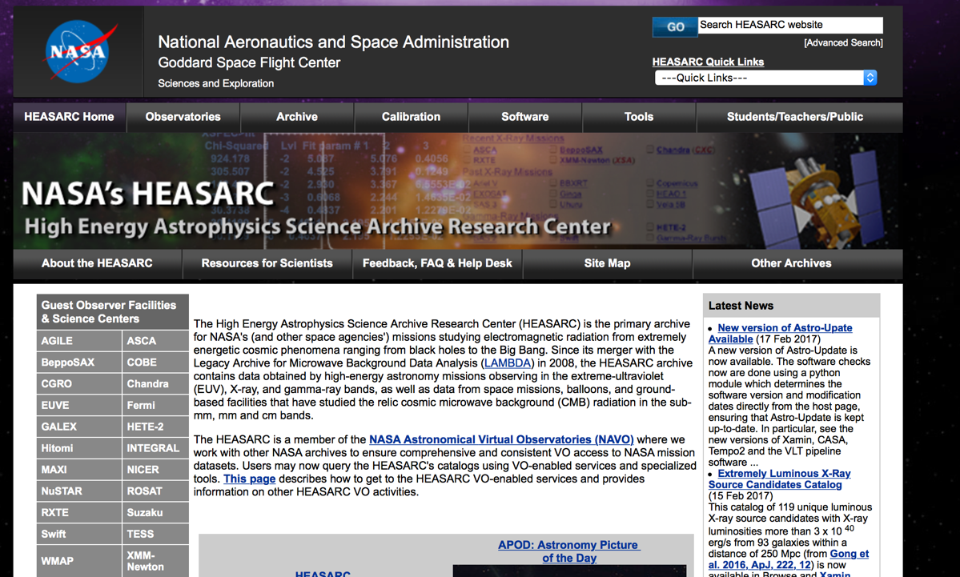
Heasarc: https://heasarc.gsfc.nasa.gov

Slide 4
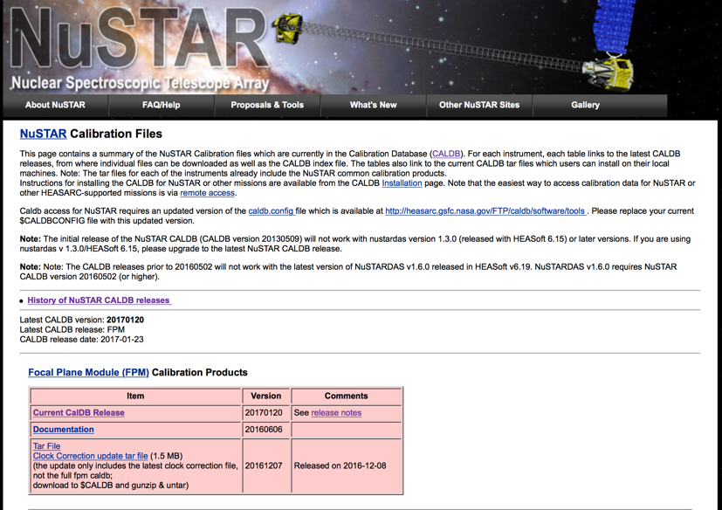
CALDB - Calibration Data Base
Every mission has a CALDB
Missions supported by heasarc have their CALDB hosted at the heasarc

Slide 5
CALDB structure and Index file
CALDB/
data/
nustar/
fpm/caldb.indx (link)
Index/caldb.indx20141014

Slide 6
Observation ID
CPPttxxxvvv - 70860010002
'C' is the "source" category, defined as follows:
0: Non-Pointing Data (e.g. IOC); Safe Hold
1: Calibration Observations (e.g. Crab nebula)
2: Solar System Objects (e.g. the Sun)
3: Galactic Compact Sources (stars, CVs, X-ray binaries, isolated neutron stars)
4: Non-ToO Supernovae, Supernova Remnants, and Galactic Diffuse Emission
5: Normal Galaxies
6: Active Galaxies and Quasars
7: Galaxy Clusters and Extragalactic Diffuse Objects and Surveys
8: Proposed Targets of Opportunity (ToOs) Observations
9: Non-proposal ToOs and Director's Discretionary Time
'PP' is two digits used to identify the program type, as follows:
00: Assigned to the first 2-year primary mission (2012 to 2014) 01, 02, etc.: Increments for each additional year of operation (synchronized with possible GO cycles)
'tt' is the program type within that 'PP'. The value is reset at each 'PP'. The 'tt' values have the following meanings:
01: Single observation of an object. 02: Multiple observations (e.g., monitoring) of the same object.
10-59: Reserved for tiling/mosaic/raster scan programs. These programs include several different targets (pointings) not at the same sky position but are very close.
60-99: Reserved for survey programs. These programs comprise observations of several objects identified to carry out a specific science investigation.

Slide 7
File structure
Slew
Science observation
Attitude file
Orbit file
Two-line element satellite position
Unfiltered event list from FPMA
Unfiltered event list from FPMB
House Keeping Directory
Central Electronics Box house keeping
Camera Head Unit 4 house keeping
Camera Head Unit 123 house keeping
Command response
Engineering
Metrology
Optical Bench Electronics Box
Disabled pixel map
Focal Plane module house keeping
Rejected events

Slide 8
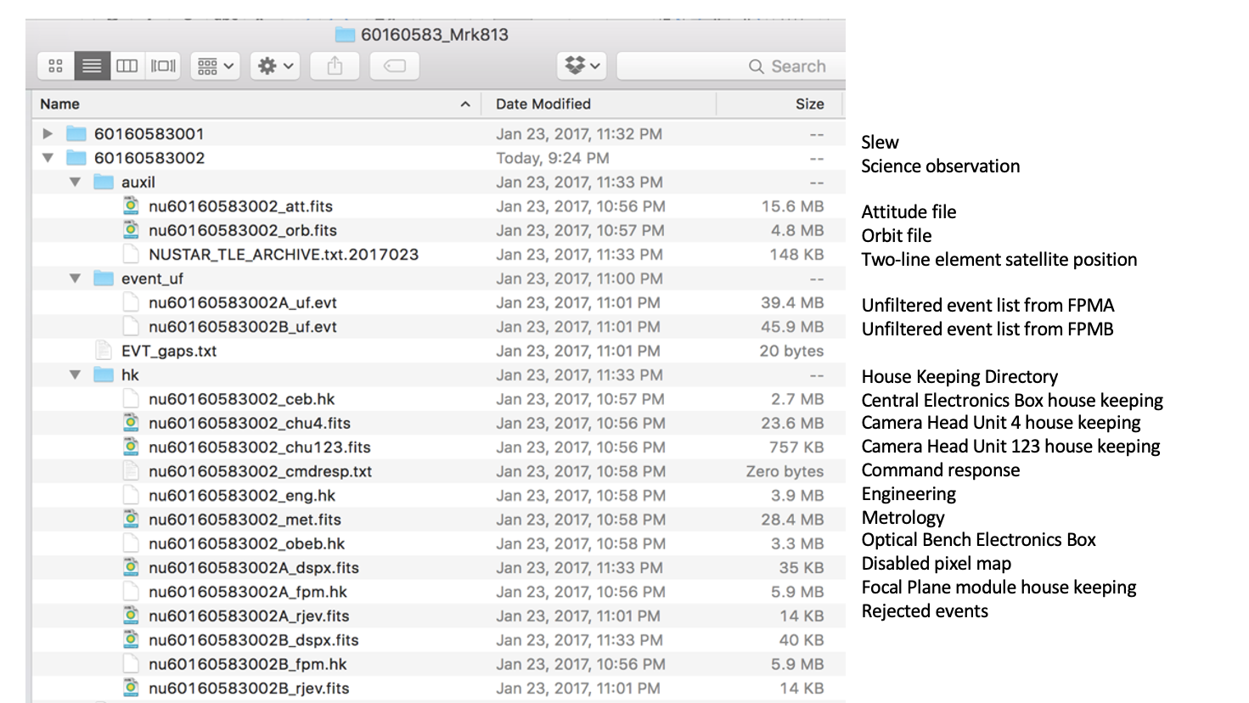

Slide 9
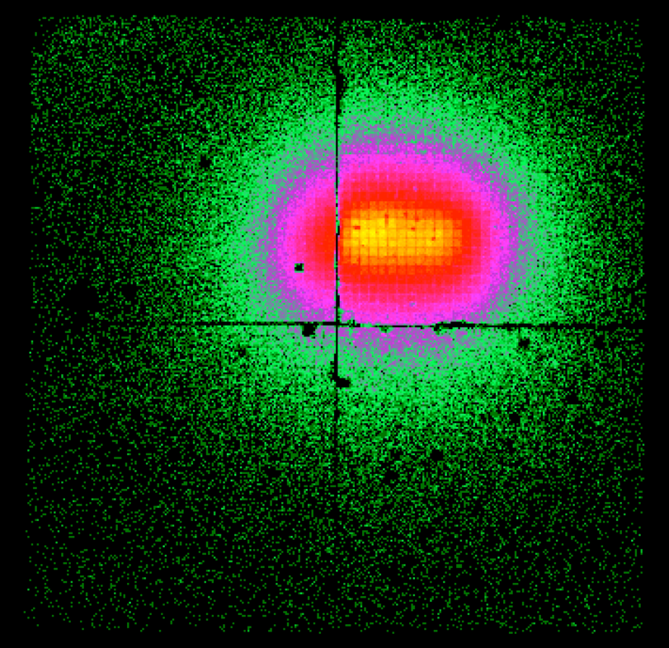
Anatomy lesson
Det 1
Det 0
Two modules: FPMA and FPMB
Each module has 4 detectors
Each detector has 32x32 pixels
Physical pixel size: 12.3”
Software pixel size 1/5th of physical: 2.45”
FoV: 4 x 4 cm = 13.5’ x 13.5’
4 cm, 13.5’
Det 2
Det 3

Slide 10
Channel to energy
PI (pulse invariant) channels: 1 – 4096
Conversion: Energy = PI*0.04+1.6 keV
3 keV = 35 channels
78 keV = 1910 channels

Slide 11
NuSTARDAS overview
SC = space craft
GTI = good time intervals
HK = house keeping
CHU = camera head unit, star tracker data
Level 1 data = SC raw data files
Level 2 data = processed SC files
Level 3 data = higher level products derived from level 2 data

Slide 12
NuSTARDAS
NuSTAR Data Analysis Software
Manual: http://heasarc.gsfc.nasa.gov/docs/nustar/analysis/nustar_swguide.pdf
Important NuSTARDAS tasks
nupipeline – lvl 1 -> lvl 2, produces cleaned event lists
nuproducts - lvl 2 -> lvl 3, produces spectra and responses
nulccorr – lvl 3, produces light curves
nusplitsc – lvl 2, splits the event list, for Mode 6
nuskytodet – transforms a sky coordinate into det1 and det2 coordinates
nuexpomap – lvl 3, produces exposure maps

Slide 13
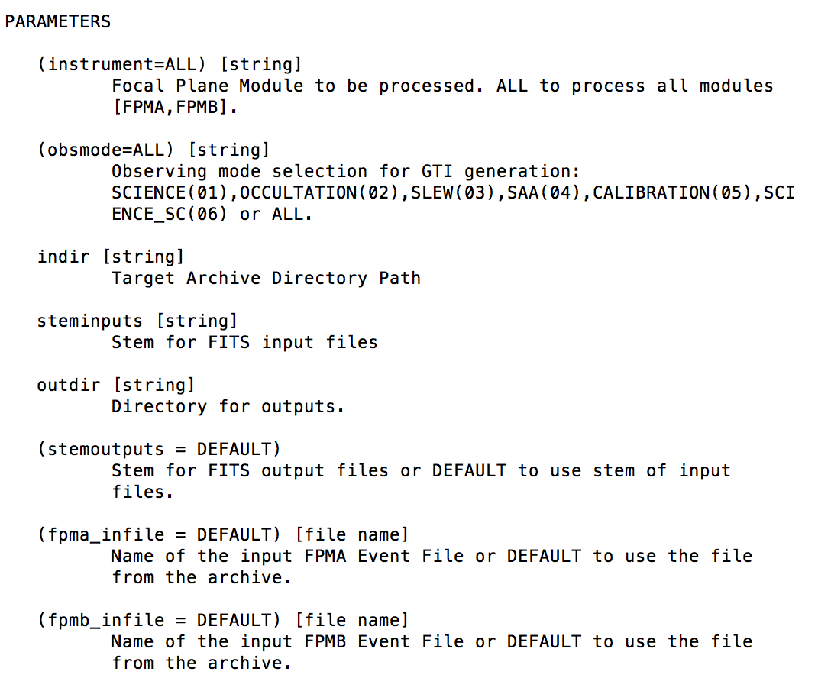
Step-by-step data reduction
untar the observation
> tar xvzf *.tar.gz
fhelp nupipeline (or google nupipeline help)

Slide 14
Step-by-step: run nupipeline
> cd 60160583_Mrk813
> ls
60160583001 60160583002
> nupipeline clobber=yes indir=60160583002 steminputs=nu60160583002 outdir=60160583002/event_cl pntra=OBJECT pntdec=OBJECT
Extras:
(obsmode=ALL) [string] Observing mode selection for GTI generation:
SCIENCE(01),OCCULTATION(02),SLEW(03),SAA(04),CALIBRATION(05),SCI
ENCE_SC(06) or ALL.
(saacalc=2) [integer] SAA calculation algorithm [1 or 2]
(saamode=NONE) [string] SAA calculation mode [NONE|STRICT|OPTIMIZED].
(tentacle=no) [boolean] If set to yes, calculate SAA tentacle flag.
(arfmlicorr=no) [Boolean] If set to yes, enables ARF MLI temperature-dependent correction
for FPMA data. GET URL FOR MLI
Discussed later: Mode 6

Slide 15
Step-by-step: saacalc, saamode, tentacle
Go to: http://www.srl.caltech.edu/NuSTAR_Public/NuSTAROperationSite/Home.php

Slide 16
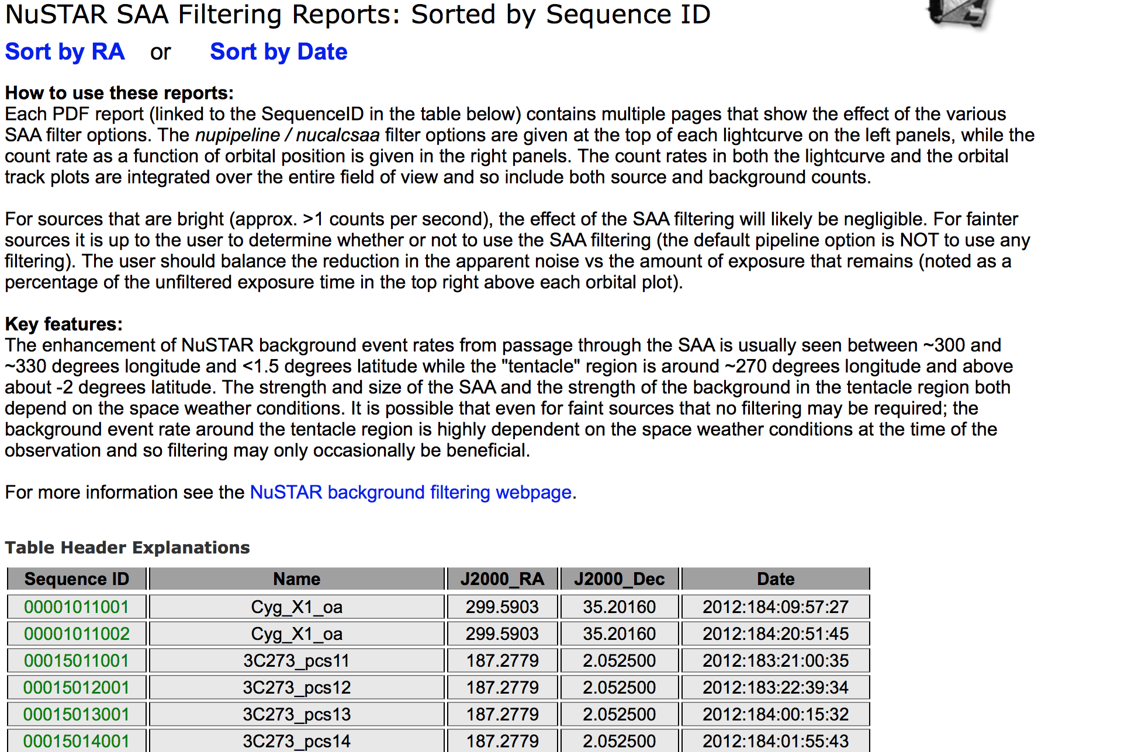
Step-by-step: saacalc, saamode, tentacle

Slide 17
Step-by-step: saacalc, saamode, tentacle

Slide 18
Day of the Tentacle

Slide 19
Step-by-step: nupipeline output
>nupipeline clobber=yes indir=60160583002 steminputs=nu60160583002 outdir=60160583002/event_cl pntra=OBJECT pntdec=OBJECT
> cd 60160583002/event_cl
> ls
nu60160583002A.attorb nu60160583002B01_cl.evt
nu60160583002A.mkf nu60160583002B01_gti.fits
nu60160583002A01_cl.evt nu60160583002B_bp.fits
nu60160583002A01_gti.fits nu60160583002B_det1.fits
nu60160583002A_bp.fits nu60160583002B_fpm.hk
nu60160583002A_det1.fits nu60160583002B_hp.fits
nu60160583002A_fpm.hk nu60160583002B_oa.fits
nu60160583002A_hp.fits nu60160583002B_uf.evt
nu60160583002A_oa.fits nu60160583002_att.fits
nu60160583002A_uf.evt nu60160583002_mast.fits
nu60160583002B.attorb nu60160583002_psd.fits
nu60160583002B.mkf nu60160583002_psdcorr.fits

Slide 20
Step-by-step: nupipeline output
nu60160583002A.attorb - attitude orbit
nu60160583002A.mkf - filter file
nu60160583002A01_cl.evt - cleaned even list
nu60160583002A01_gti.fits - good time intervals
nu60160583002A_bp.fits - bad pixel file
nu60160583002A_det1.fits - det1 reference file
nu60160583002A_fpm.hk - housekeeping FPM
nu60160583002A_hp.fits - hot pixel
nu60160583002A_oa.fits - optical axis file
nu60160583002A_uf.evt - unfiltered event list
nu60160583002_att.fits - attitude pointing file
nu60160583002_mast.fits - mast solution file
nu60160583002_psd.fits - position sensitive detector file
nu60160583002_psdcorr.fits - corrected psd file

Slide 21
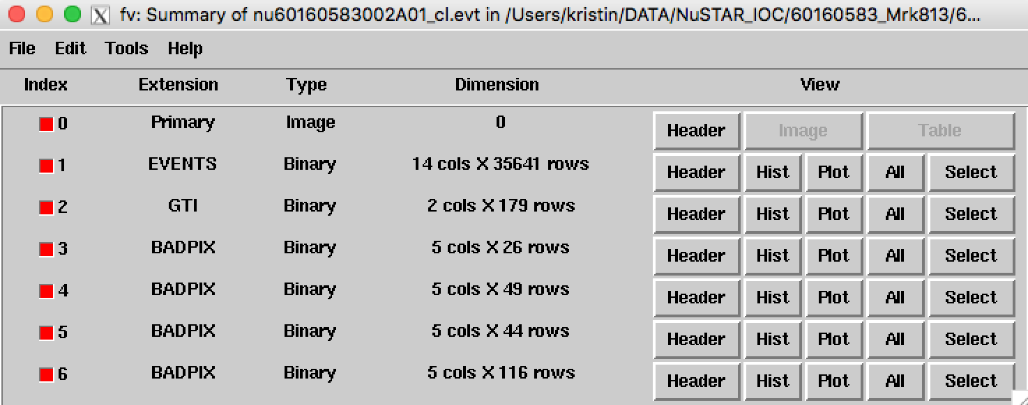
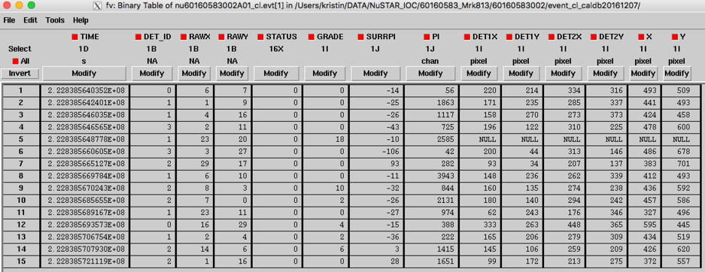
Step-by-step: event list format
> fv nu60160583002A01_cl.evt

Slide 22
Step-by-step: DS9 looking at the images
Coordinate differences of up to 8”

Slide 23
Step-by-step: DS9 looking at the coordinates
DET1
DET2
SKY
MAST
S/C - jitter

Slide 24
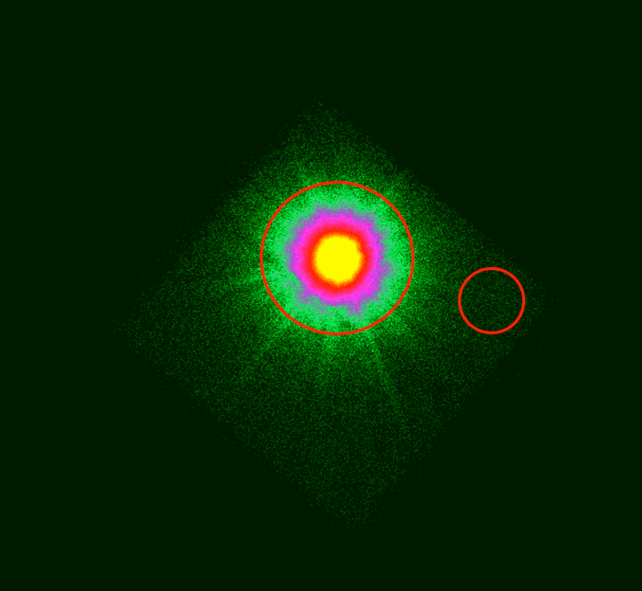
Step-by-step: DS9 taking source and background regions
Faint case
Bright case
Rule of thump: Get the background as big and close as possible to the source, preferably on the same detector where the majority of the counts fall.

Slide 25
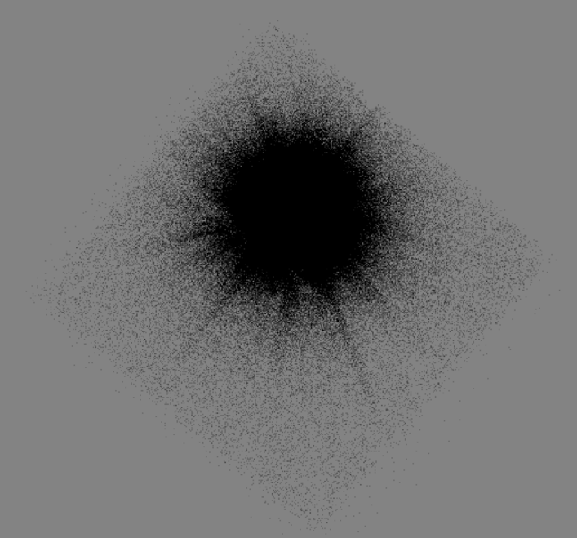
Bright case

Slide 26
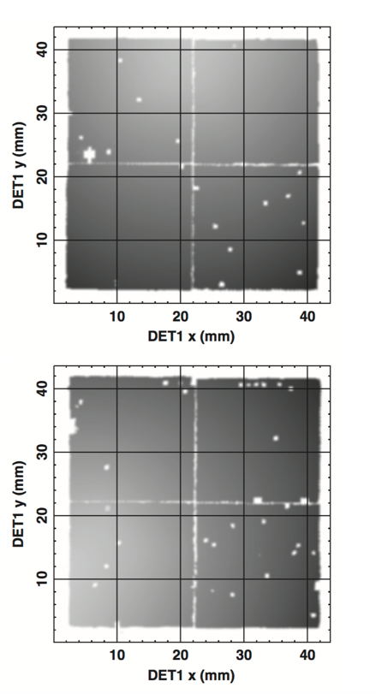
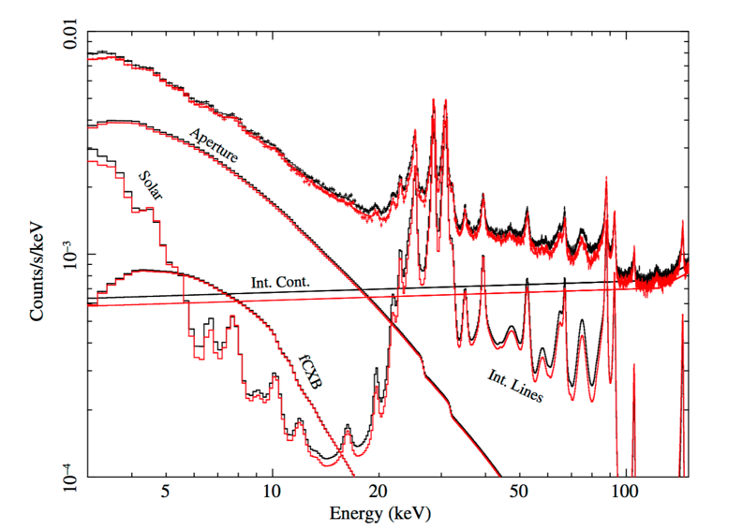
Step-By-Step: Truths about the NuSTAR Background
Aperture gradient
Details on the background can be found in Wik et al 2014, ApJ, 792, 48

Slide 27
Step-by-step: source and background regions. ADDITONAL POINTS
Bigger regions means more counts but also bigger background, which is not always good. Sometimes smaller is better, but too small the quality goes down. Try various extraction region sizes to find the right one.
Source extraction regions can only be circles or annuli.
Background regions can be any shape (almost)
Faint case
Bright case

Slide 28
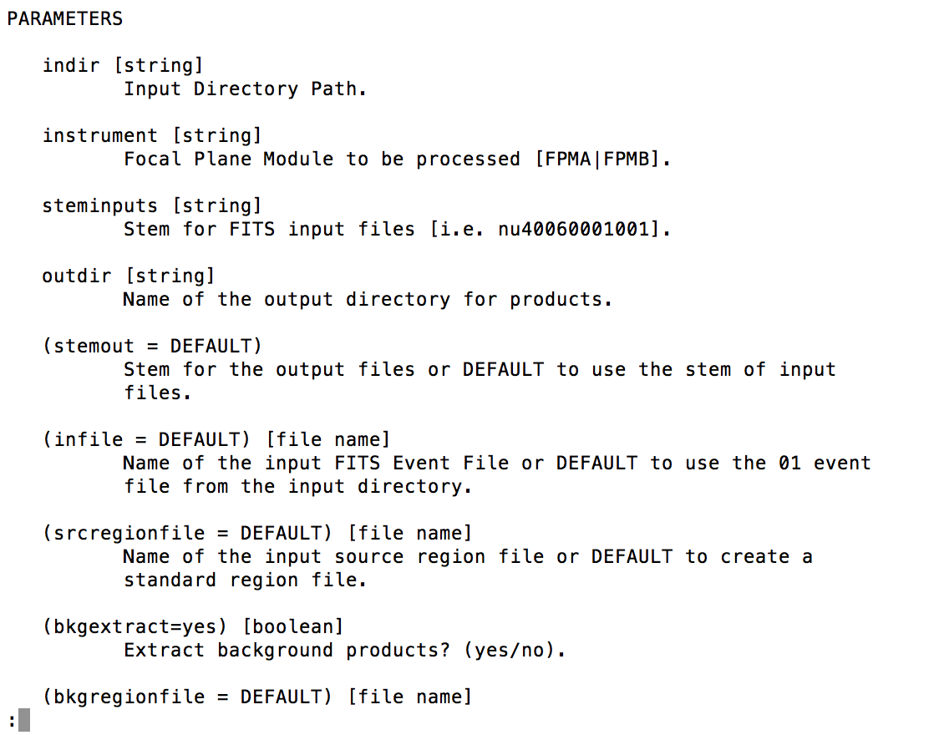
Step-by-Step: nuproducts
Extracting spectra:
> fhelp nuproducts

Slide 29
Step-by-Step: nuproducts
>set DATAPATH=60160583_Mrk813/60160583002/event_cl
>set STEM=nu60160583002
>nuproducts indir=$DATAPATH steminputs=$STEM outdir=${DATAPATH}/srcA instrument=fpma /
srcregionfile=${DATAPATH}/srcA.reg /
bkgregionfile=${DATAPATH}/bkgA.reg /
clobber=yes
Things I like to add
(offaxishistofile=NONE) [file name] Name of the output Off-Axis Histogram or DEFAULT to use stem or NONE for none (only if extended=no).
(offaxisfile=NONE) [file name] Name of the output Off-Axis File or DEFAULT to use stem or NONE for none (only if extended=no).

Slide 30
Step-by-Step: nuproducts
EXTRAS: lightcurves
(binsize=10) [real] Bin size (seconds) for the light curve.
(lcfile = DEFAULT) [file name] Name of the output source light-curve file or DEFAULT to use stem or NONE for none.
(bkglcfile = DEFAULT) [file name] Name of the output background light-curve file or DEFAULT to use stem or NONE for none (only if bkgextract=yes)
(pilow = 35) [integer] Minimum PI value for light curve and image extraction.
(pihigh = 1909) [integer] Maximum PI value for light curve and image extraction.
(correctlc=yes) [boolean] If set to yes, nulccorr task is executed.
(lcenergy = 10) [real] Energy value for PSF and vignetting calculation in LC correction (keV).
(lcpsfflag=yes) [boolean] If set to yes, apply PSF correction to LC file (used only if extended=no).
(lcexpoflag=yes) [boolean] If set to yes, apply EXPOSURE correction to source and background LC files (used only if extended=yes).
(lcvignflag=yes) [boolean] If set to yes, the vignetting correction is applied to LC file.

Slide 31
Step-by-Step: nuproducts
EXTRAS: barycentering (correcting arrival times for NuSTAR’s motion around the sun)
(barycorr=no) [boolean] If set to yes, barycenter correction is executed.
(clockfile=CALDB) [filename] Name of the Clock Correction File or CALDB (used only if barycorr=yes).
EXTRAS: Extended ARF
(extended=no) [boolean] Extended source?(yes/no).
(boxsize=20) [integer] Size in pixel for the subimage boxes (used if extended=yes).
(pilowarf=35) [integer] Minimum PI value for subregion ARF weight calculation (only if extended=yes).
(pihigharf=1909) [integer] Maximum PI value for subregion ARF weight calculation (only if extended=yes).
(flatflagarf=no) [boolean] If set to yes, use flat distribution for addarf execution (only if extended=yes).
EXTRAS: User GTI
(barycorr=no) [boolean] If set to yes, barycenter correction is executed
(clockfile=CALDB) [filename Name of the Clock Correction File or CALDB (used only I barycorr=yes)
orbitfile [filename] Name of the input Orbit FITS File (used only if barycorr=yes)
srcra_barycorr [real] Source RA position in decimal degrees (used only if barycorr=yes)
srcdec_barycorr [real] Source DEC position in decimal degrees (used only if barycorr=yes)
(outfile=DEFAULT) [filenam] Name of the output barycenter corrected FITS Event File or DEFAULT to use stem (used only if barycorr=yes).

Slide 32
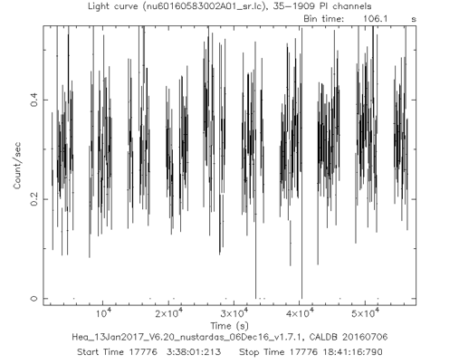
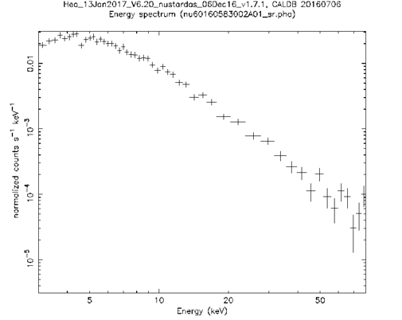
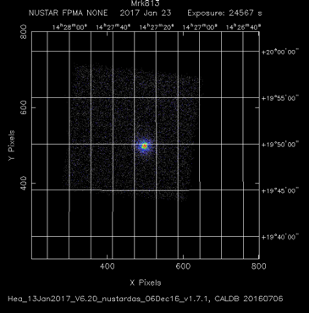
Step-by-Step: nuproducts output
Background light curve
Background spectrum
Off axis file
Fits image
Effective area file
Source light curve
Source spectrum
RMF

Slide 33
ARF

Slide 34
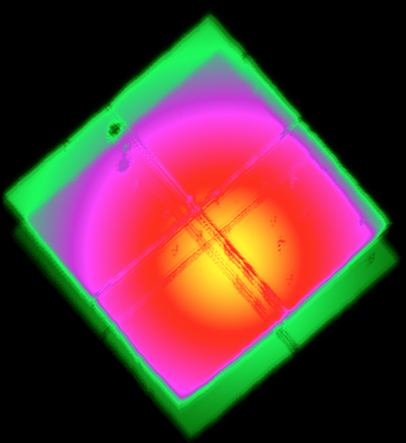
Nuexpomap
This minimum set of commands will give you an exposure map vignetting corrected at 10 keV with a the off axis angle binned at 5 pixels.

Slide 35
Nuexpomap important parameters
(vignflag=yes) [boolean]
If set to yes, the vignetting correction is applied.
(energy = 10) [real]
Energy value for vignetting calculation (keV).
(pixbin = 5) [integer]
Bin size of aspect histogram in pixels (pixel size = 2.46 arcsec).

Slide 36
Non-regular NuSTAR reductions
Mode 6
Stray Light
nuskybkg

Slide 37
What is “Mode 6”?!
In ‘nupipelin’ there is a setting obsmode=
01 – SCIENCE: science data
02 – OCCULTATION: occultation data
03 – SLEW: slew data
04 – SAA: SAA data
05 – CALIBRATION: Calibration source data
06 – SCIENCE_SC: Science Spacecraft = Mode 6!!

Slide 38
But what is mode 6?!
Normal “mode 1” science mode is aspect reconstructed using CHU (camera head unit) #4
“Mode 6” is when the aspect reconstruction is performed by the SC bus, which is not as accurate as CHU4.
SC bus not able to account for the source location in the optics.
Thermal deformations of CHU1,2 & 3 mounting
When does Mode 6 occur? When CHU4 is blinded:
Sun
Earth
Moon
Continuous viewing zone
CHU4
CHU1
SC bus
CHU3
CHU2
Notes:
During normal science mode we keep track of where we are with the startracker camera head unit #4. Mode 6 occurs when CHU4 is blinded and in that case we have to use the SC information to reconstruct photons on the sky. Since that information is not as accurate because the SC has thermal deformations in the CHUs and the bus is not capable of knowing the exact source location with respect to the optics, the reconstruction is not always … good

Slide 39
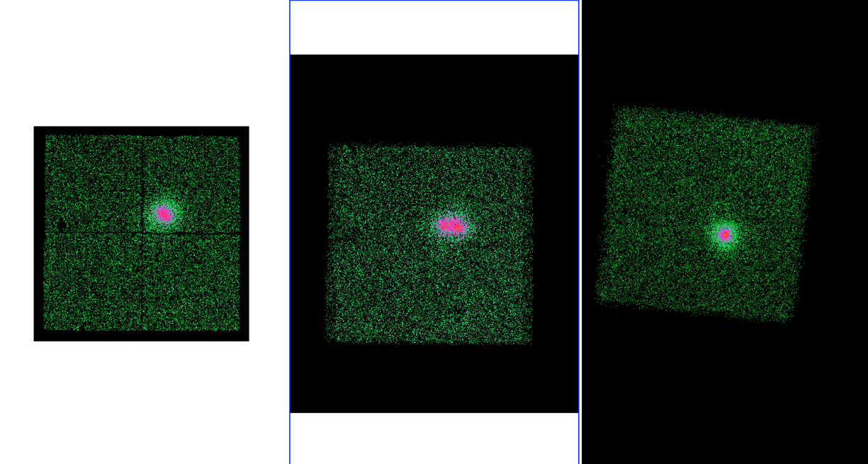
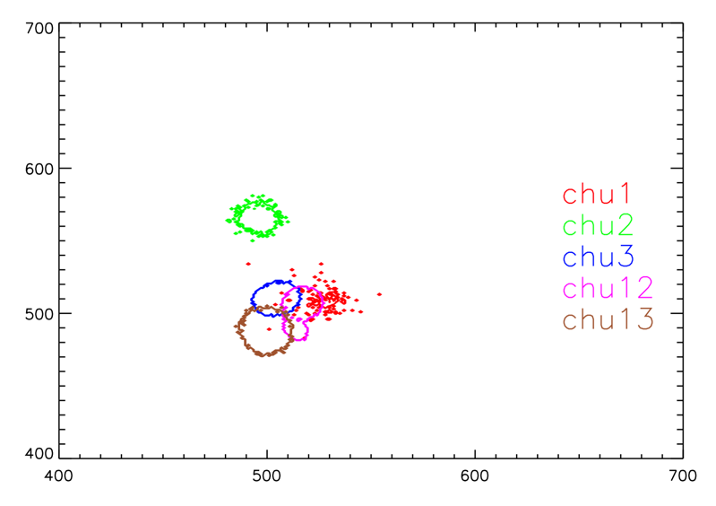
Mode 6 (or SC mode)
DET1
DET2
SKY
MAST
S/C - jitter
Notes:
Here is Cygnus X-1 subjected to a trainwreck. What is happening here is that as NuSTAR goes around its orbit the CHU’s are switching… In order to be more flexible we have been doing more mode 6 observatons and

Slide 40
nusplitsc – a NuSTAR Ftool
PARAMETERS
infile [file name]
Name of the input SCIENCE_SC (06) FITS Cleaned Event File.
chu123hkfile [file name]
Name of the input CHU123 Housekeeping FITS File.
hkfile [file name]
Name of the input Housekeeping FITS File.
(chu123rangefile=CALDB) [filename]
Name of the input CHU123RANGE file or CALDB. If set to CALDB
(default), use the file in the Calibration Database.
(splitmode=NORMAL) [string]
CHU123 splitting mode (NORMAL, STRICT).
(timecut=no) [boolean]
If set to yes, the non simultaneous CHU1/CHU2/CHU3 time
intervals are excluded.
CHU flickering:
…22211111211111211111…
Strict will NOT extract a GTI for a CHU solution if it is alone. Will cause data loss.
Timecut can further deal with flickering by excluding non-simultaneous time stamps. Will cause data loss.
Time CHU1 CHU2
x x
x
x
x x
Not included
Notes:
So it was quite necessary to construct a tool that allowed us to utilize this extra time and recover the precious photons.

Slide 41
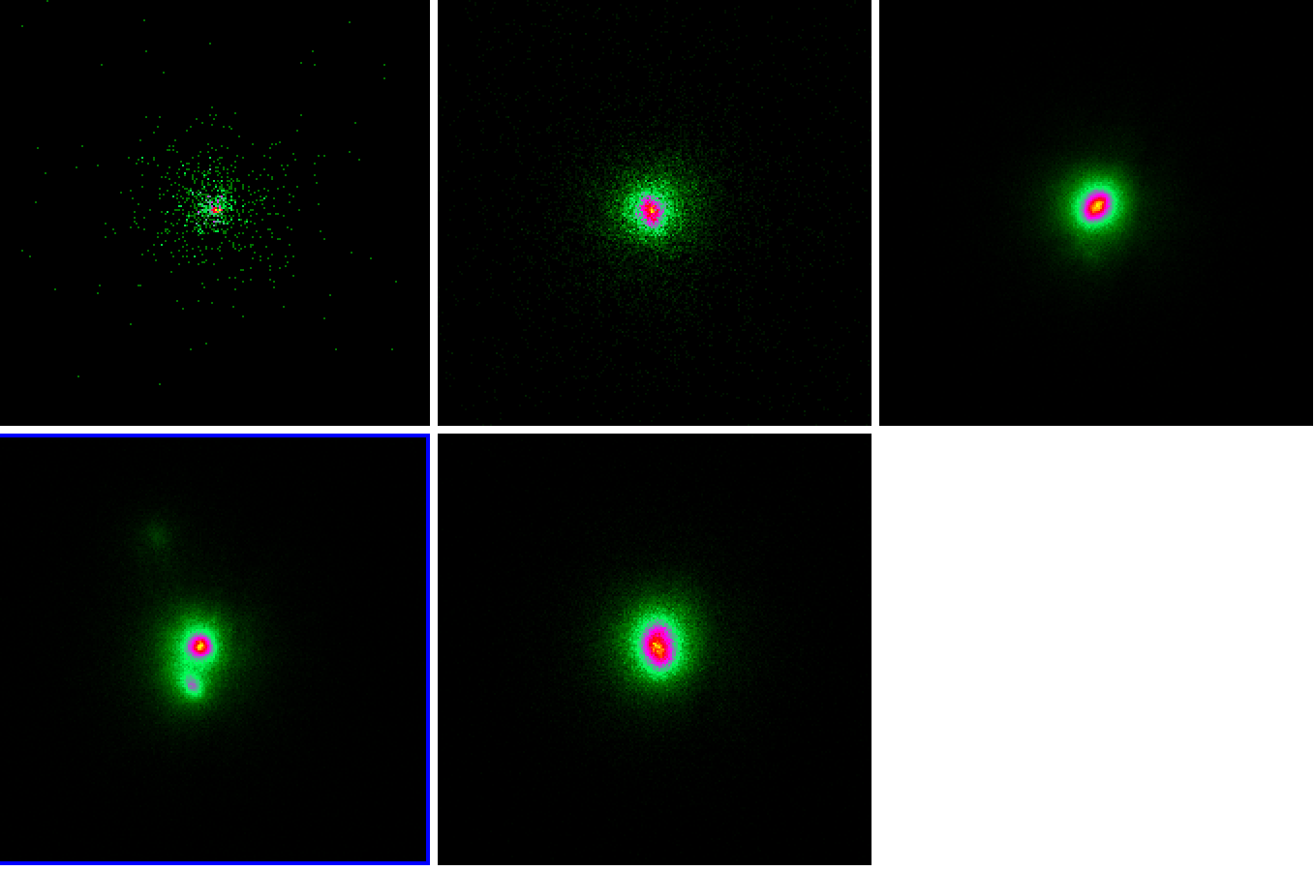
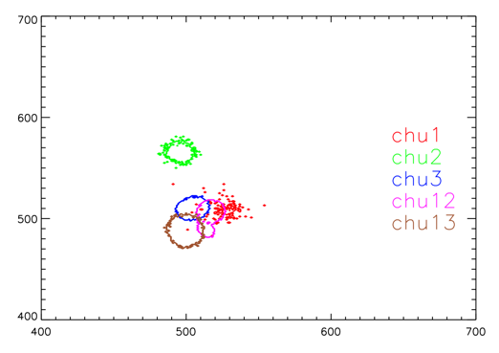
nuscsplit
CHU1
CHU2
CHU3
CHU12
CHU13

Slide 42
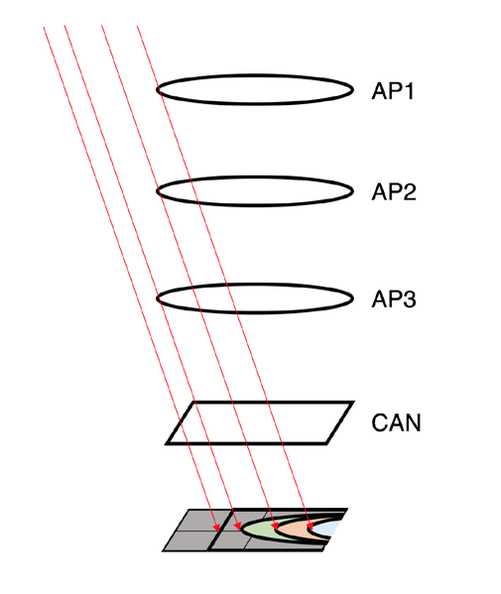
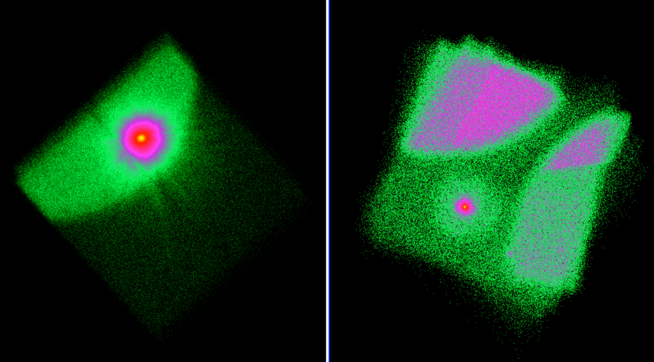
Stray Light
Stray Light is light that enters through the apertures and reached the focal plane without being interrupted by reflection or absorption. Arrive from angles 2 – 5 deg

Slide 43
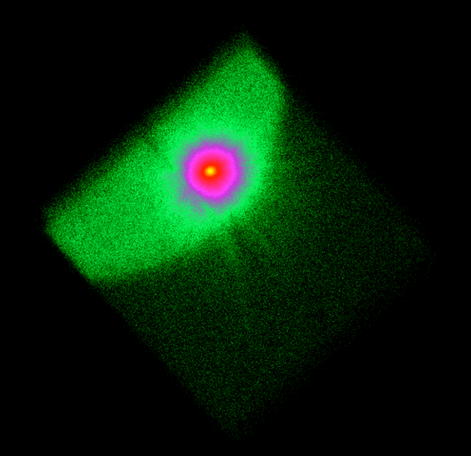
Stray Light
What to do?
Take background from the SL region

Slide 44
nuskybkg
Sometimes backgrounds can not be obtained from the observation itself.

Slide 45
nuskybkg
Nuskybkg is IDL based and can be obtained from the nustar GITHUB: https://github.com/NuSTAR
Comes with (fairly) easy to follow instructions.

Slide 46
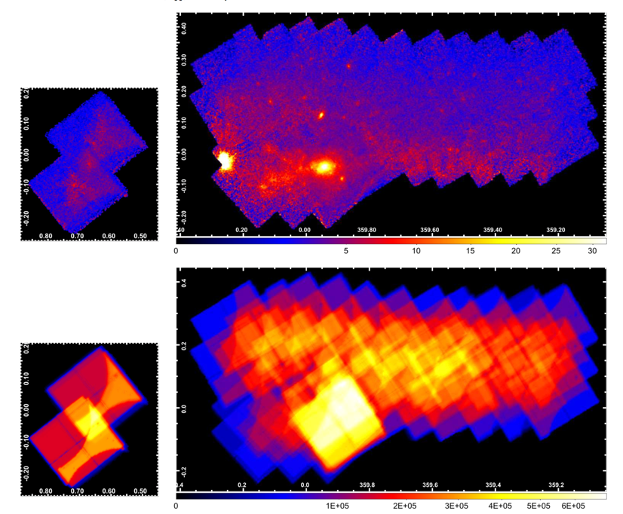
Ximage
For making mosaics: https://heasarc.gsfc.nasa.gov/docs/software/lheasoft/xanadu/ximage/manual/ximage.html
Counts images
Exposure maps

Slide 47
Ximage: mosaics

Slide 48
Other useful commands
For modifying header keywords use fthedit
fthedit infile[ext] keyword operation value
Example: fthedit ”*01_sr.pha[1]" ANCRFILE add arfA.arf
For combining spectra with the same RMF but different ARF and background use addascaspec
addascaspec [-qh] list_file out_spec out_response [outbgd]
Example:
addascaspec listallA specallA.pha arfallA.arf specallA.bkg
See fhelp for details on the listallA file structure.
If you need to combine RMFs, which is not usually recommended, then use addrmf
addrmf [file1,file2,..] [wt1,wt2,...] [rmffile=<rmffile>]
Example: addrmf foo.rmf,goo.rmf 0.5,0.5 hoo.rmf
The resulting RMF is big and will load slowly, so use cmprmf to compress it
cmprmf infile outfile threshold
Example: cmprmf hoo.rmf hoo_cmpr.rmf 1e-5

Slide 49
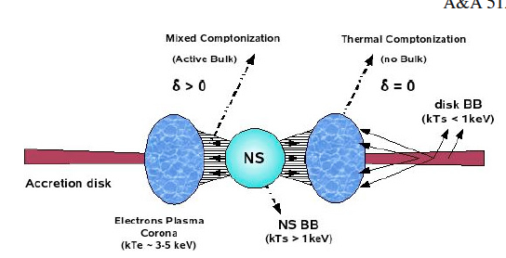
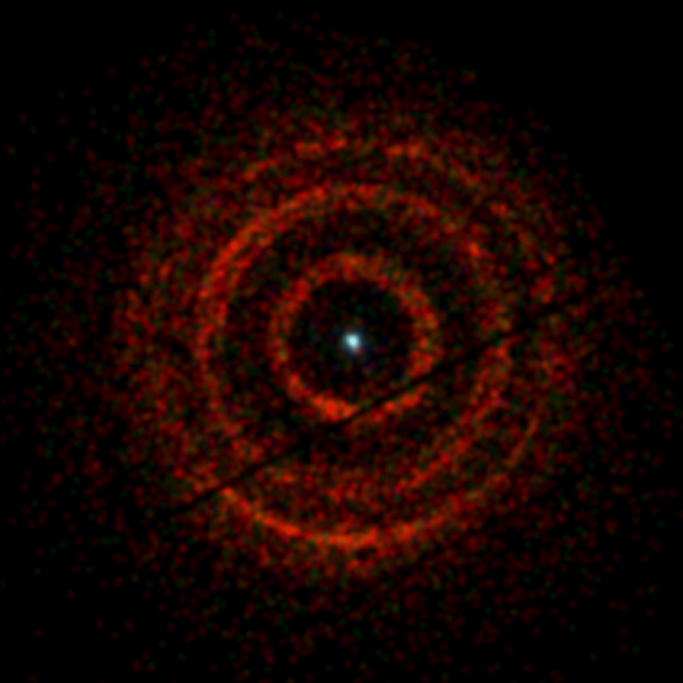
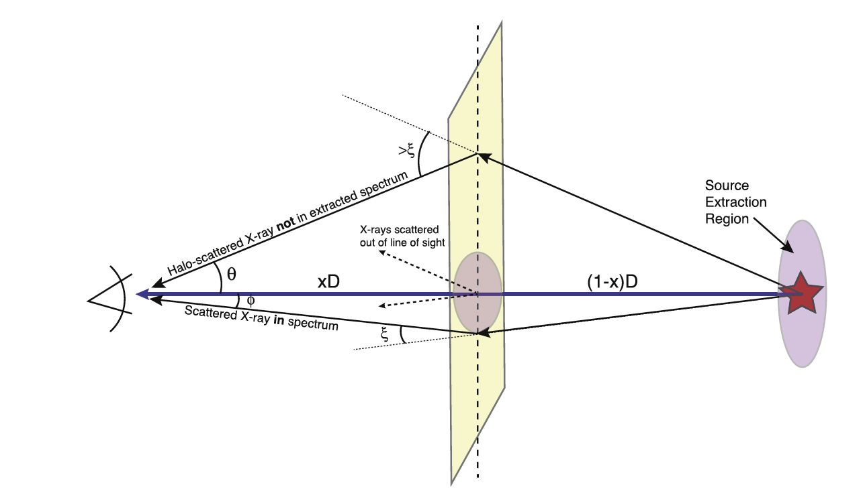
GX13+1: LMXB
Type I X-ray burster (thermonuclear); Z source
GX 13+1
E⁻² dependency
V404 Cyg
Swift
Smith et al, 2002, ApJ, 581

Slide 50
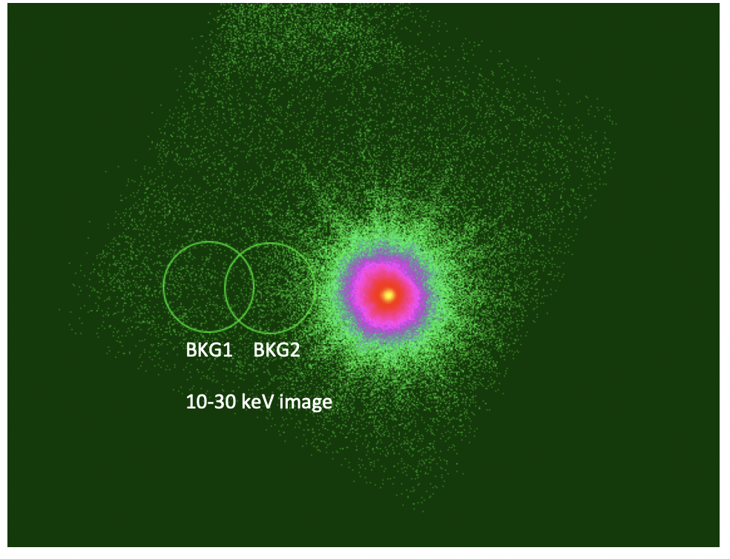
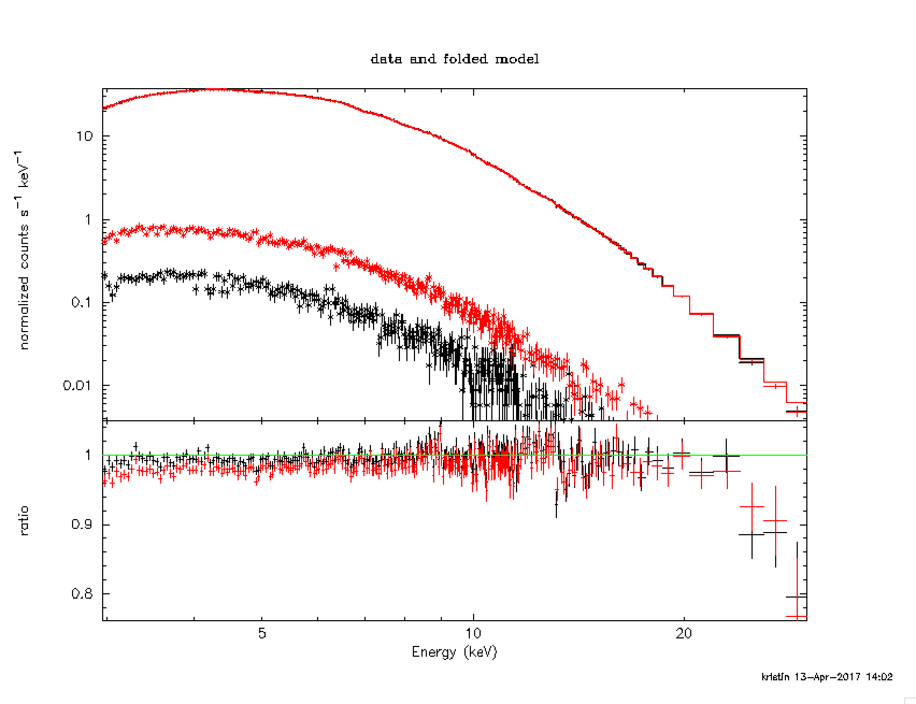
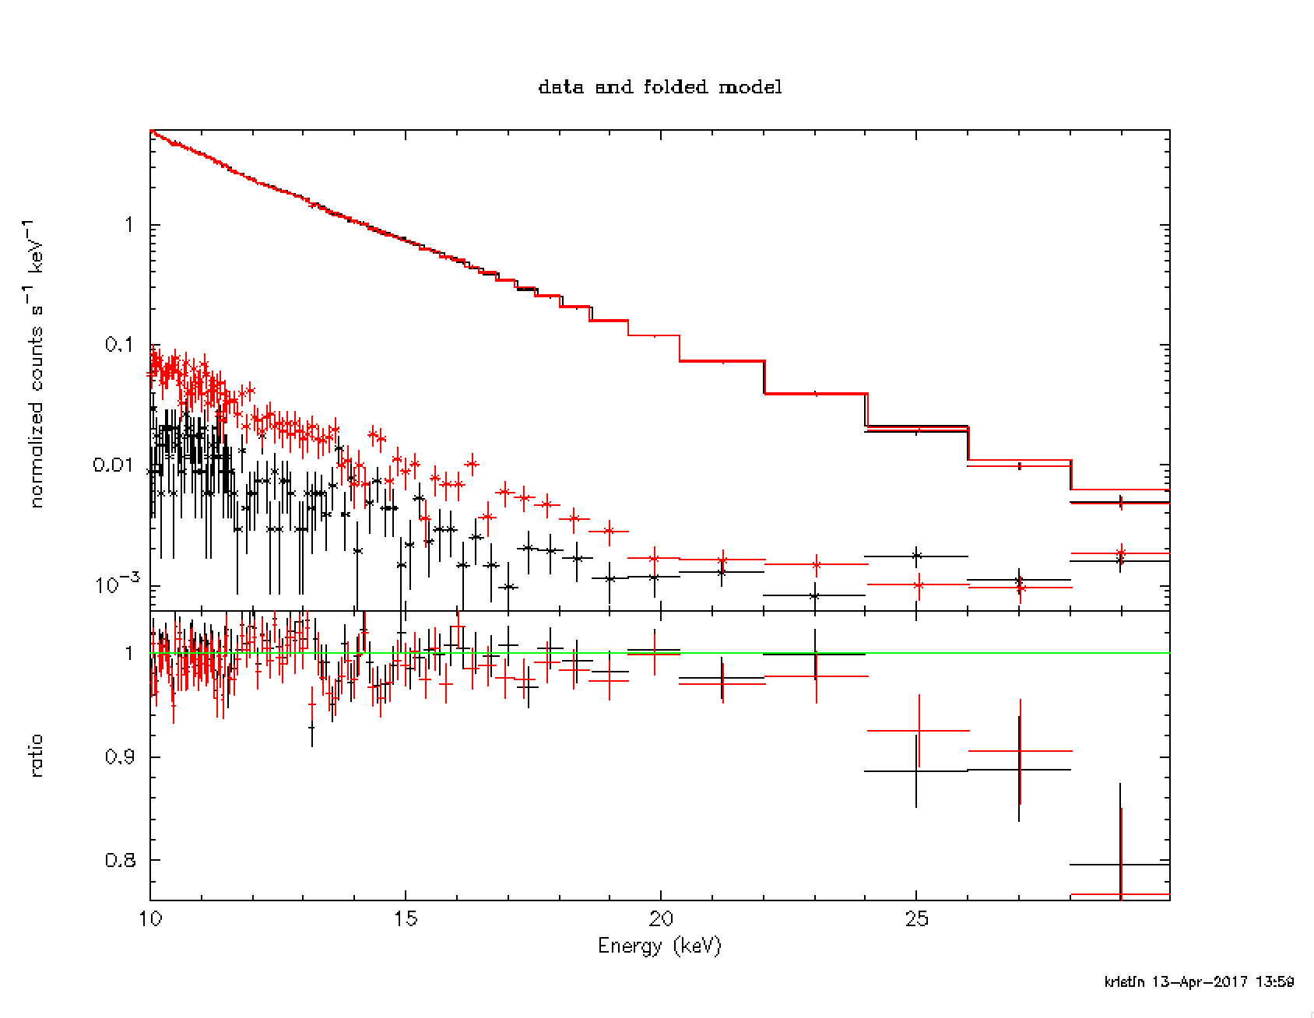
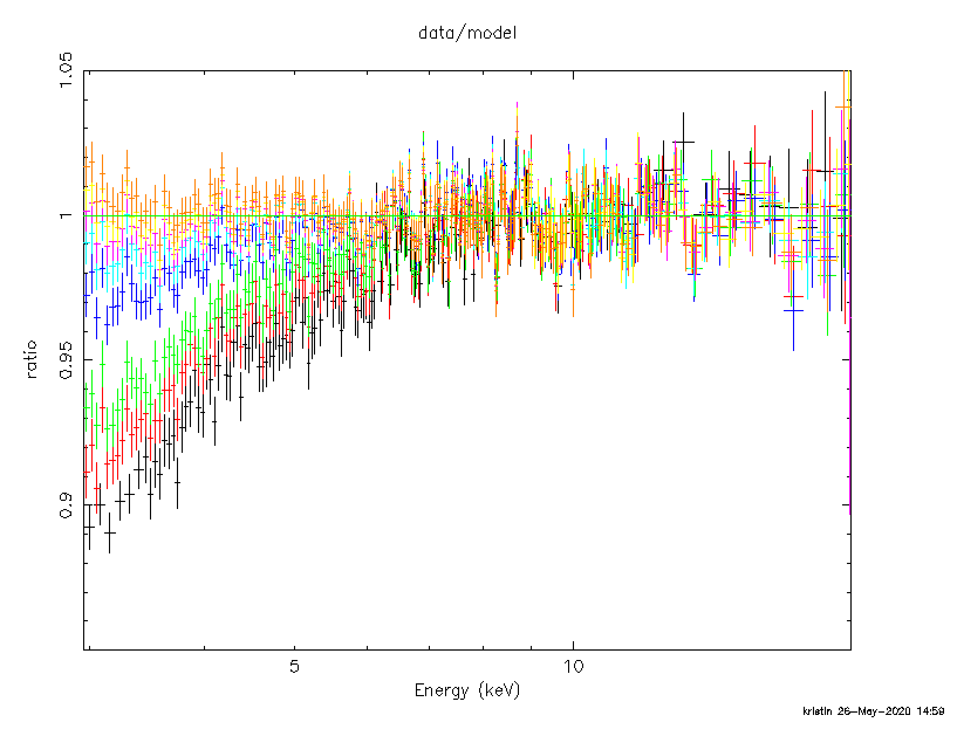
GX13+1: Background
The highest energies of the source is 30-35keV. In principle because of the halo dying out we can actually get the background at that energy right next to the source. However, if we take the background too close then the overall flux of the source is reduced.
BKG1 is the black and BKG2 is the red. Between 20 and 30 keV the two backgrounds are practically the same. It is clear that BKG2 will over subtract the low energy. Based on this we should use BKG1.
However, every part of the detector is contaminated by the dust scattering halo. In the end had to use nuskybkg.
Dust scattering

Slide 51
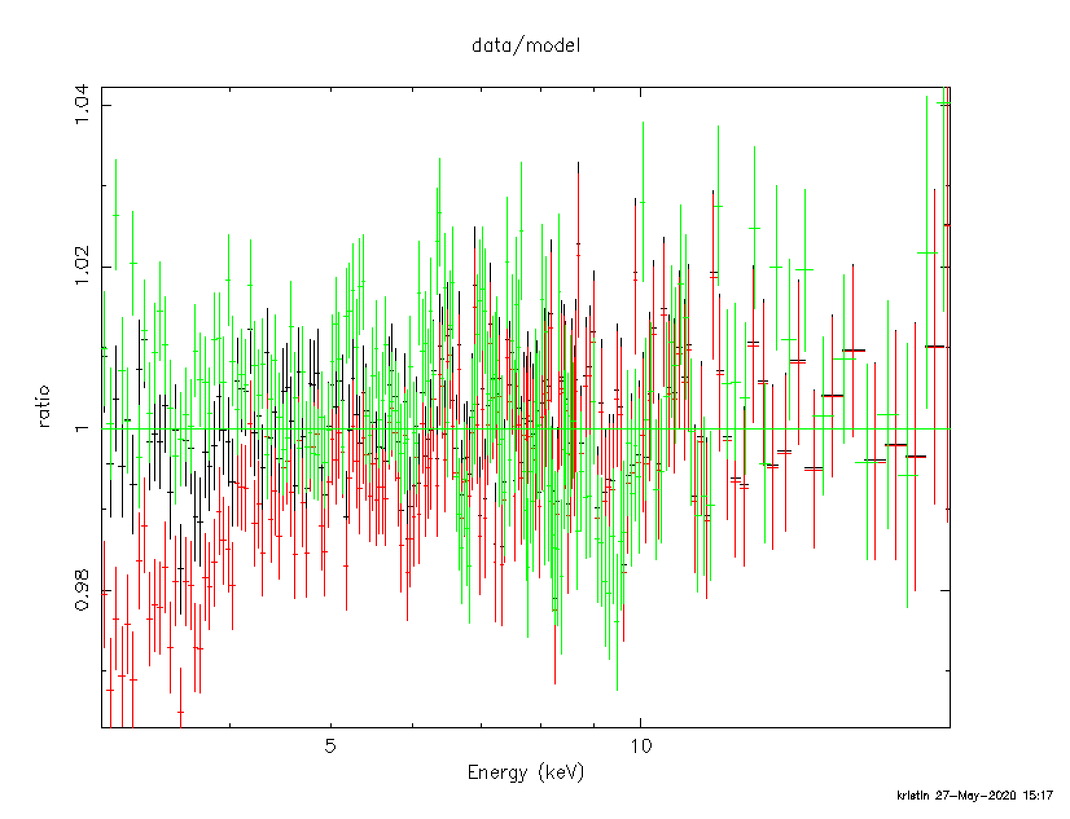
GX13+1: MLI
Black = FPMA, no MLI corr
Red = FPMA, MLI corr
Green = FPMB
The MLI correction over corrected
-> Turn off the MLI correction

Slide 52
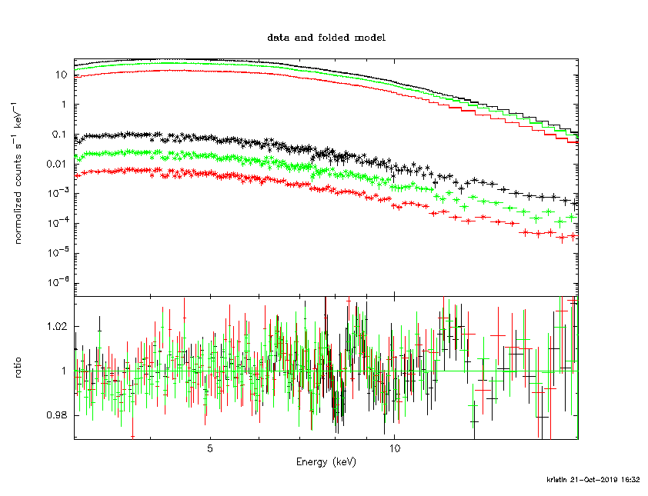
GX13+1: Dust scattering
XSCAT

Slide 53
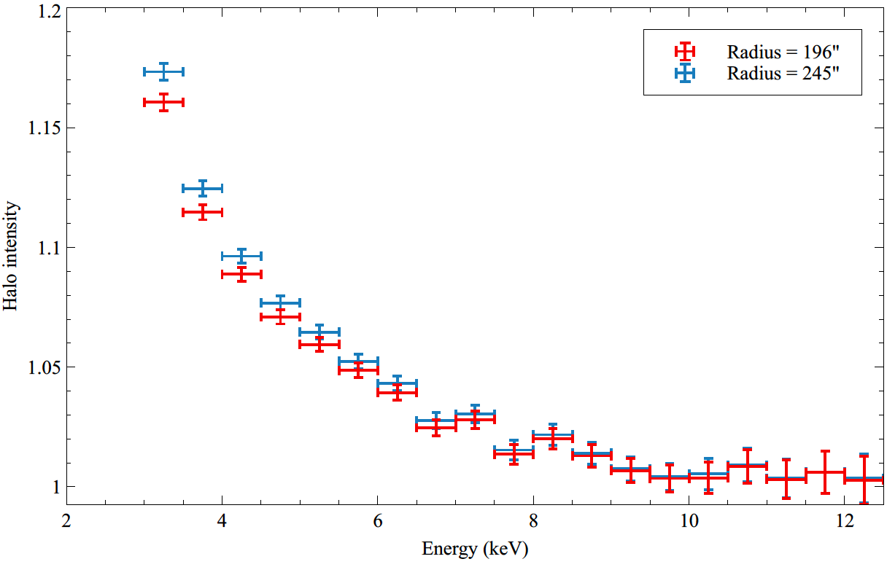
Halo intensity: Used to derive grain size and types

Slide 54
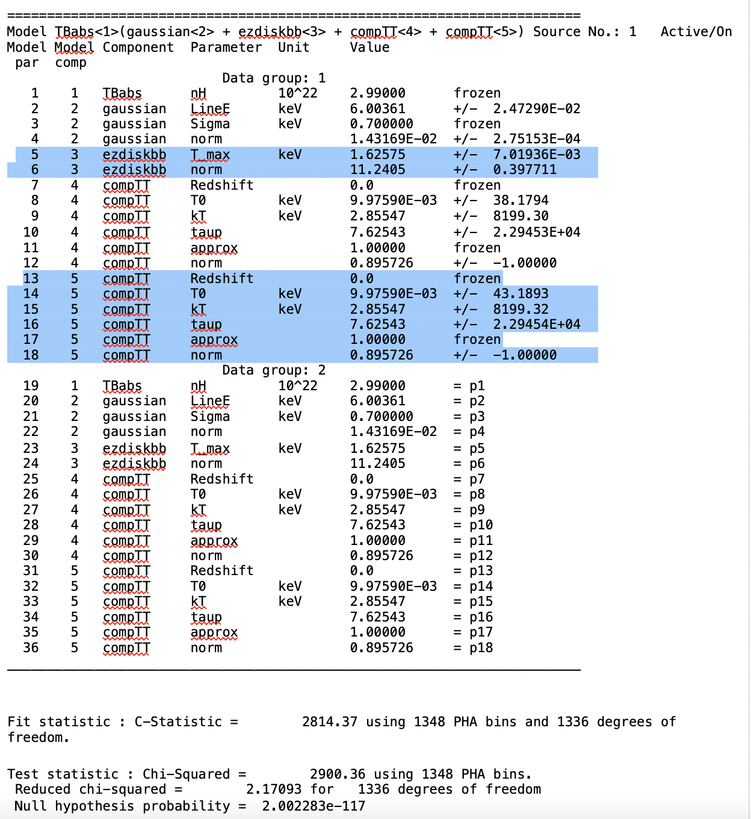
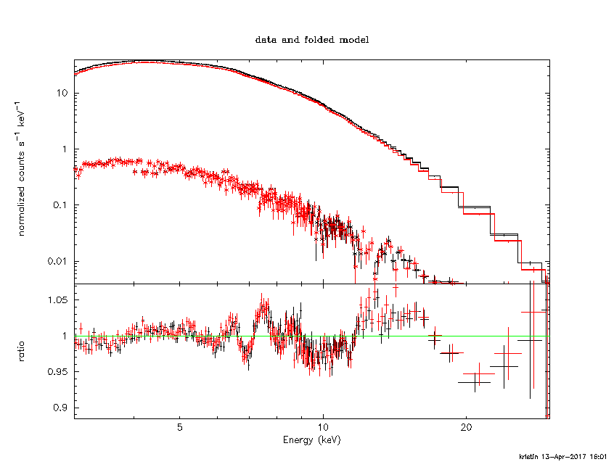
GX 13+1: physical model

Slide 55
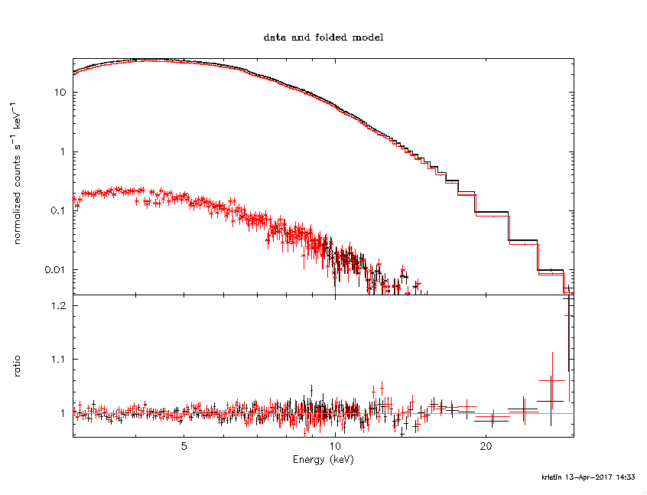
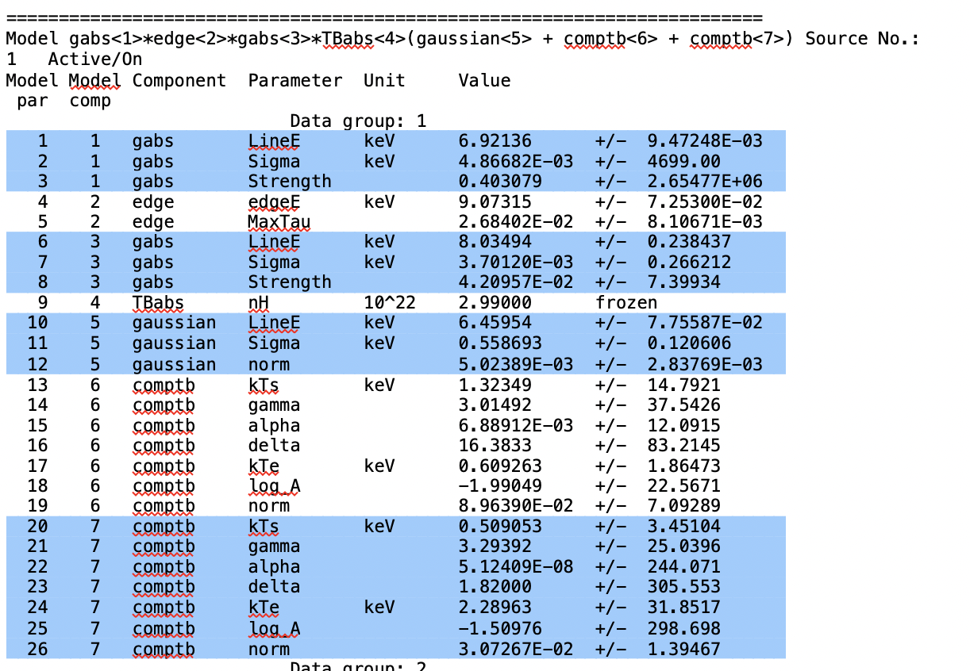
GX 13+1: emperical

Slide 56
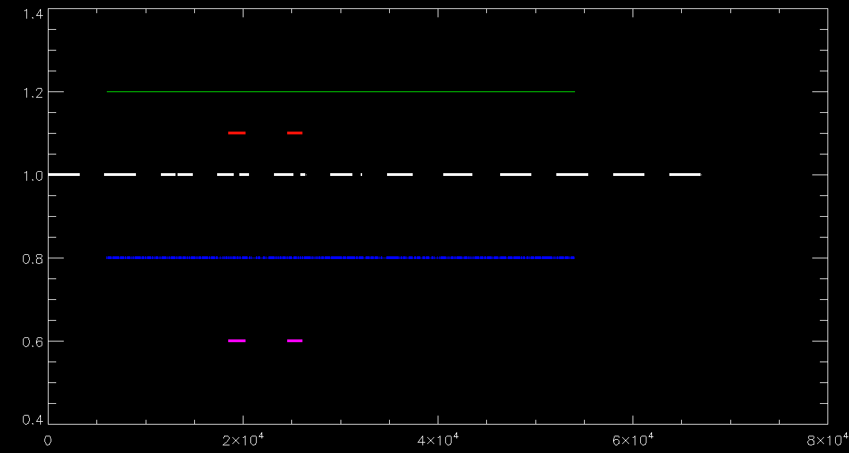
GX13+1: XMM+Swift+NuSTAR
XMM-Newton
Swift
NuSTAR
Time (sec)

Slide 57
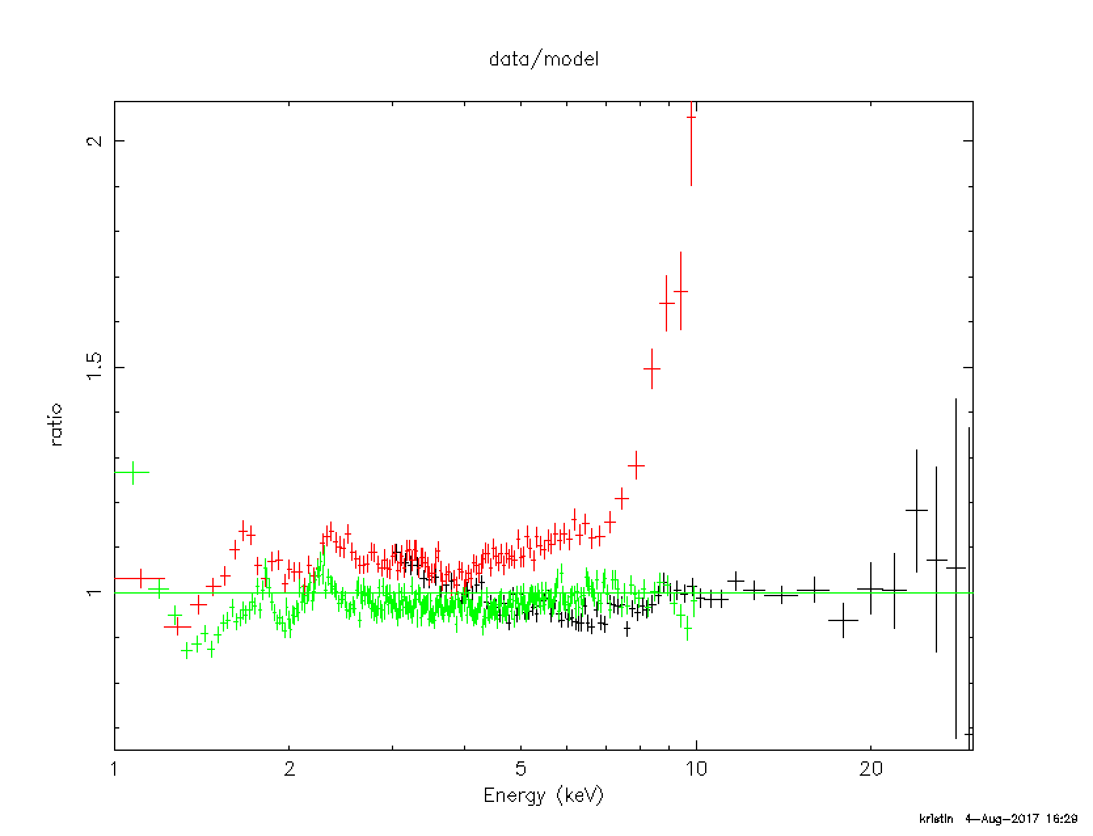
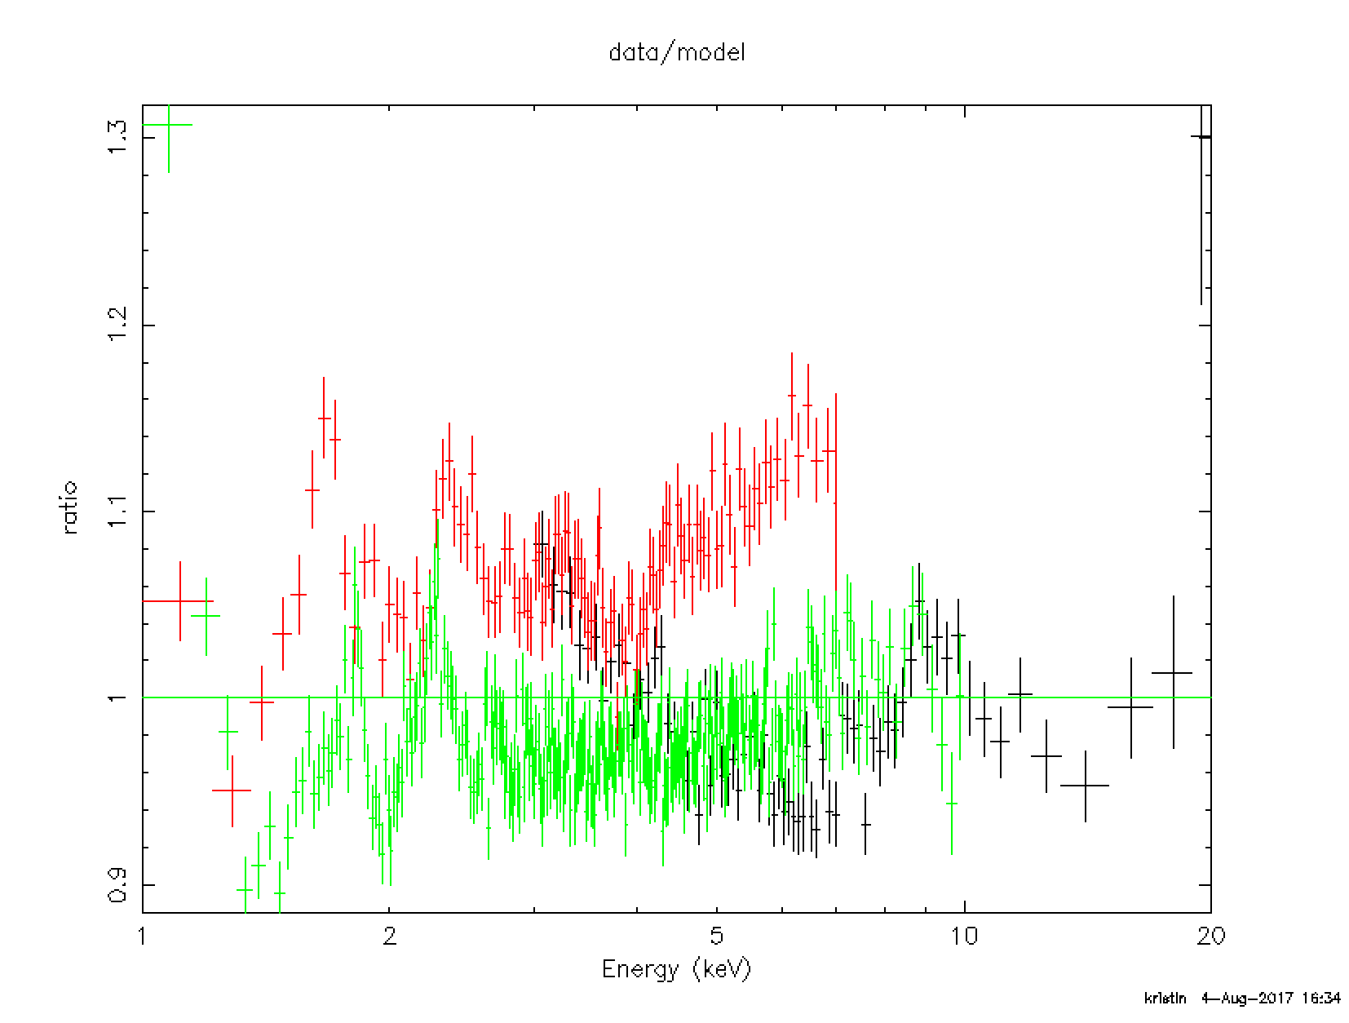
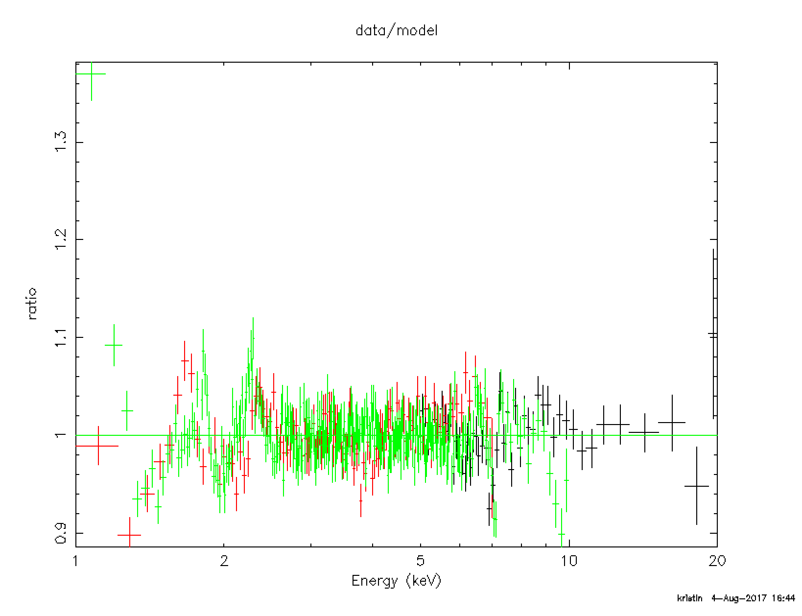
GX13+1: XMM+Swift+NuSTAR
This is the joint fit with no adjustments (spectrum_nustar_xmm_swift.pco):
TBabs(gaussian + comptb + comptb)
I ignore NuSTAR above 20 keV
I ignore Swift above 7 keV
Ignore NuSTAR between 3 - 5 keV
Nustar = 0.95
Swift = 1.09
Xmm= 0.99
Strict timing

Slide 58
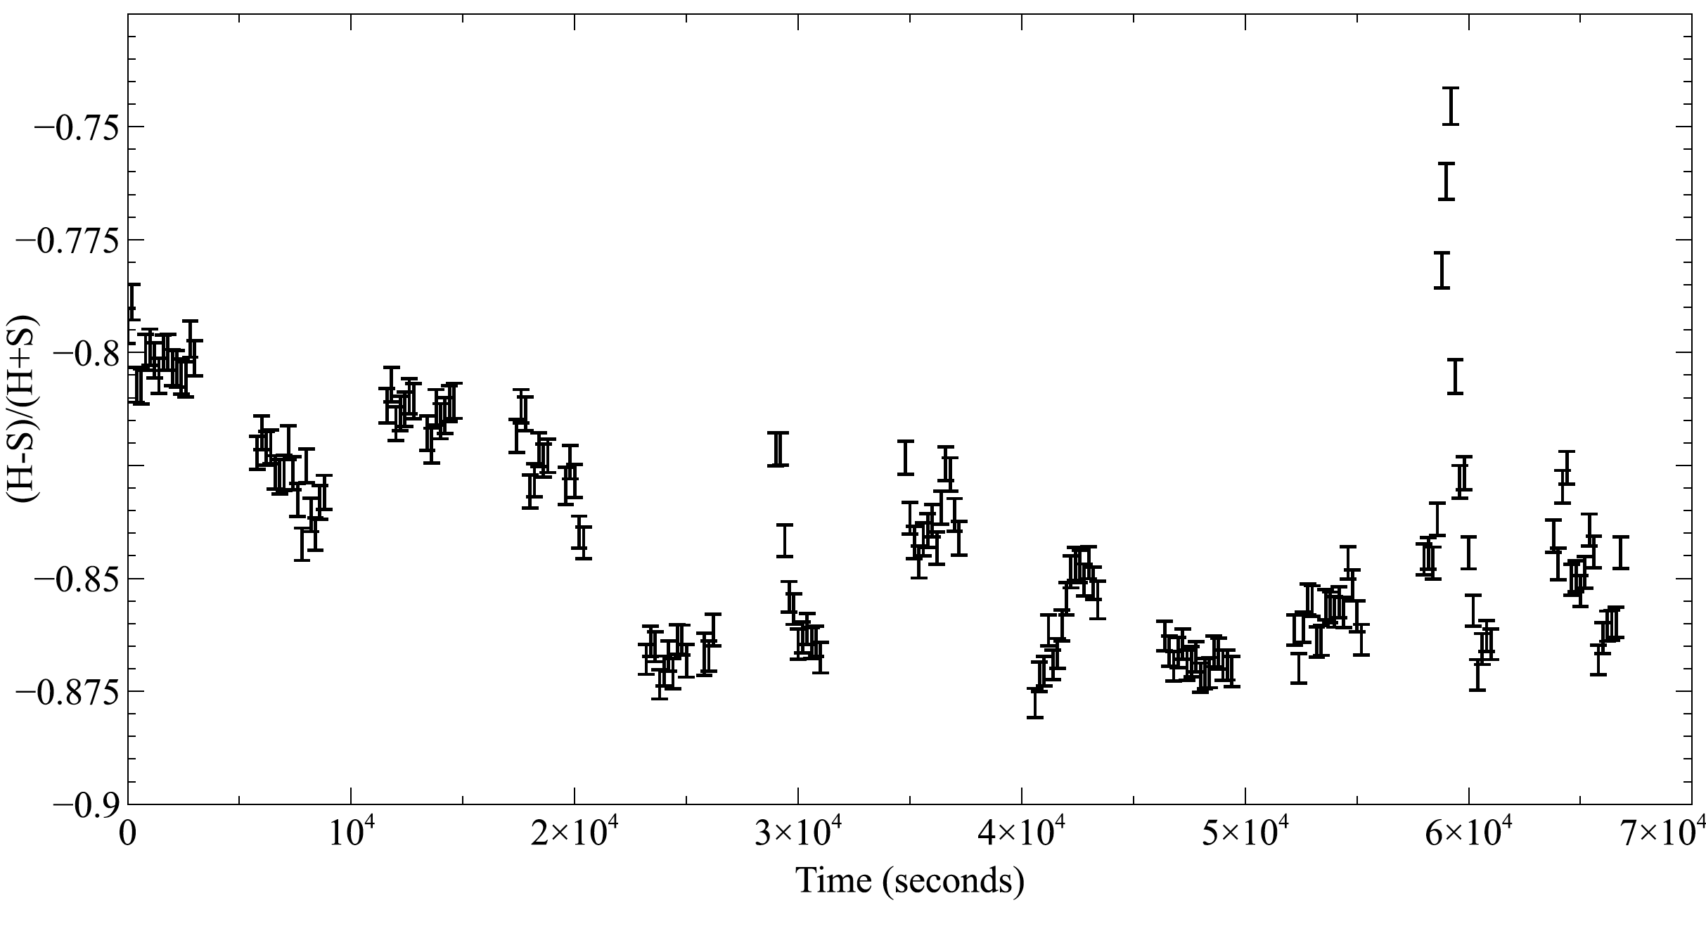
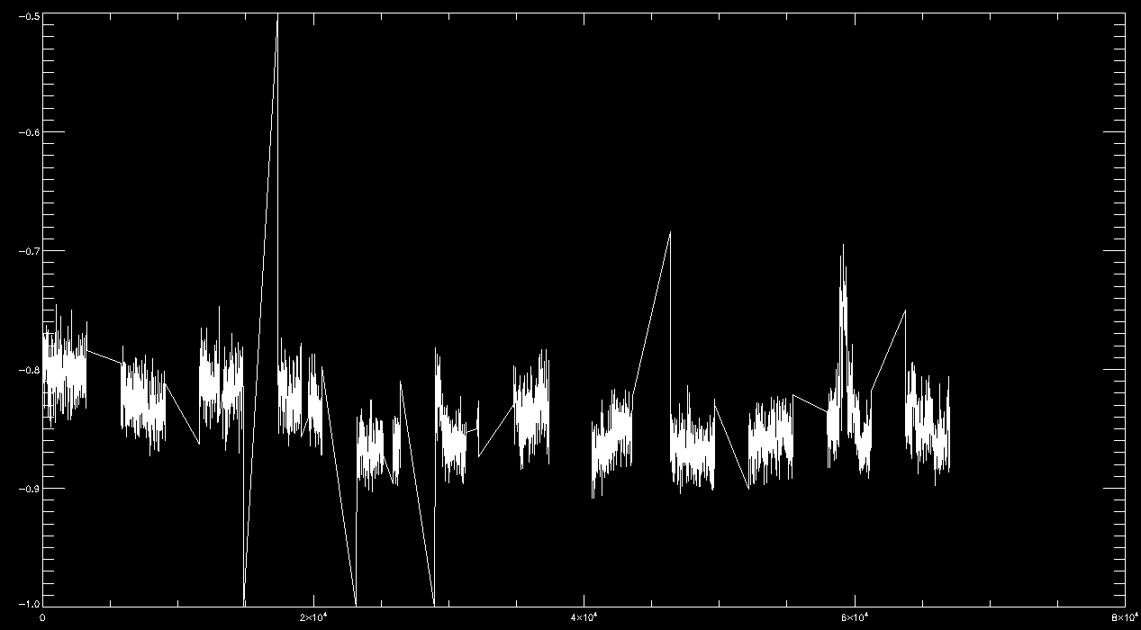
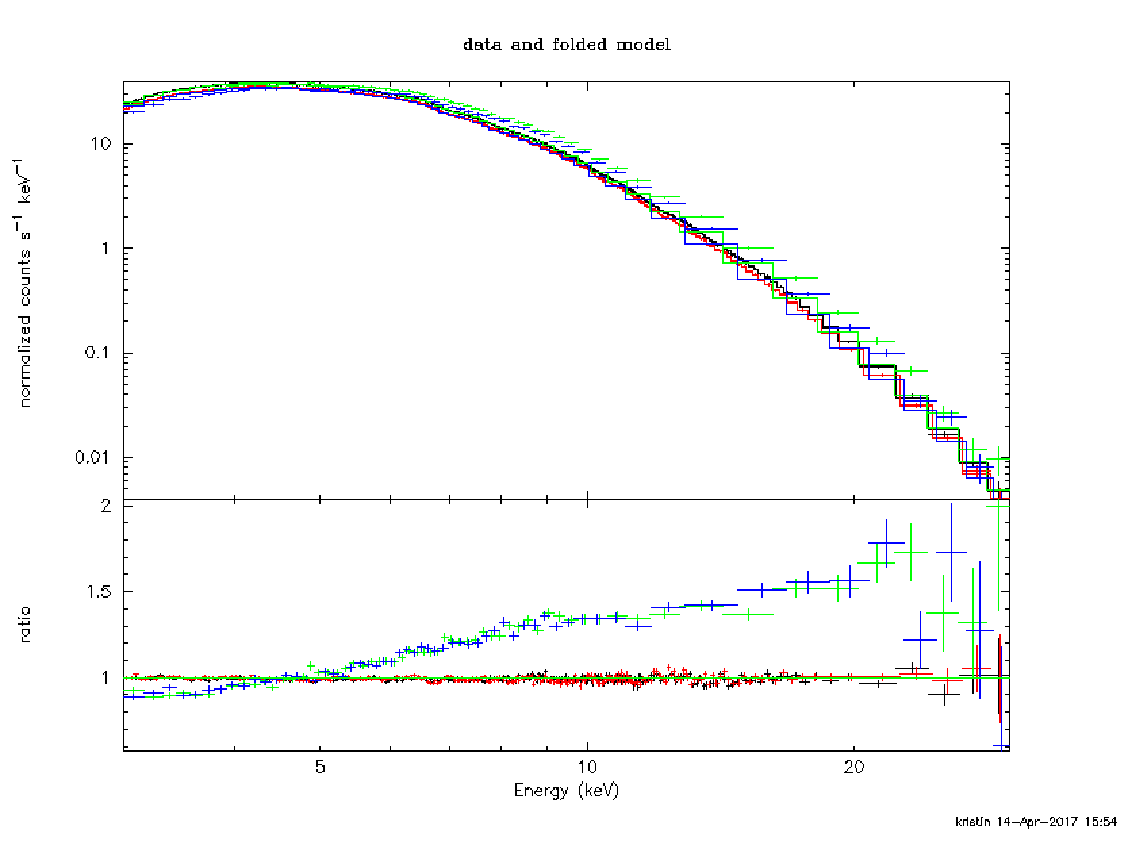
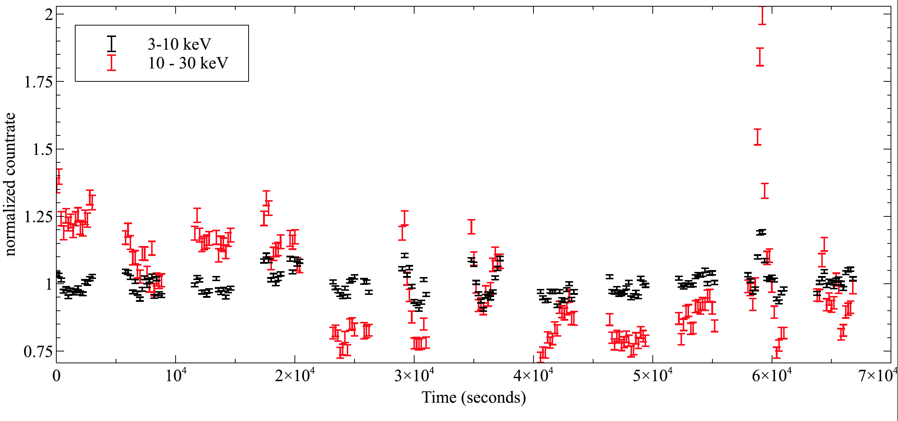
GX 13+1: Light curve

Slide 59
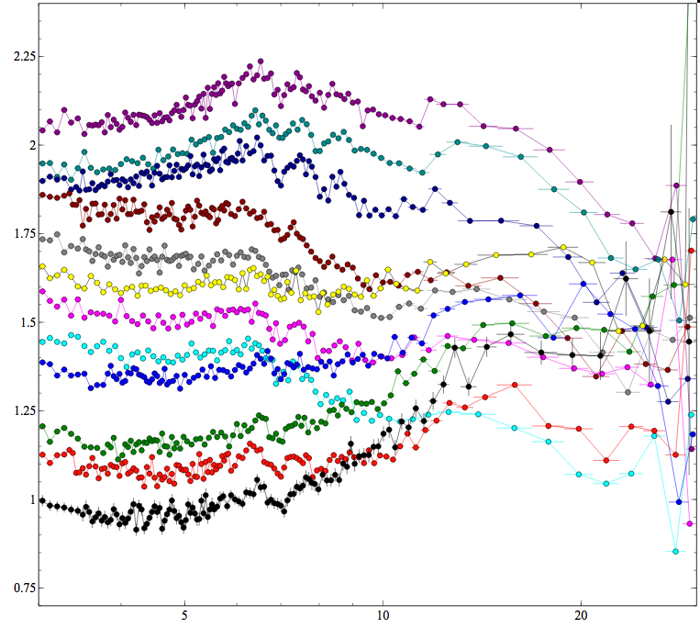
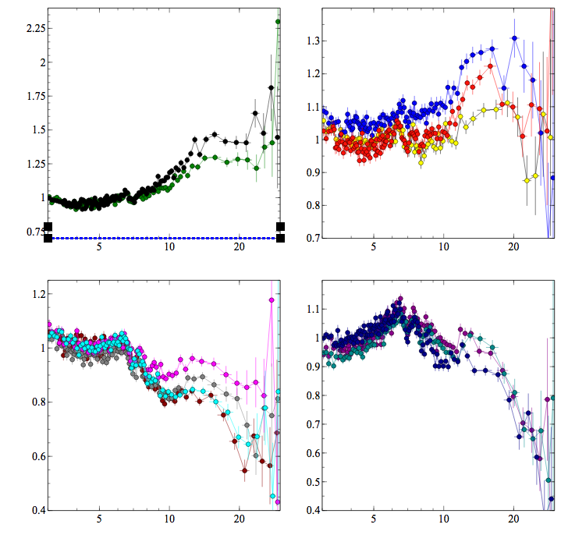
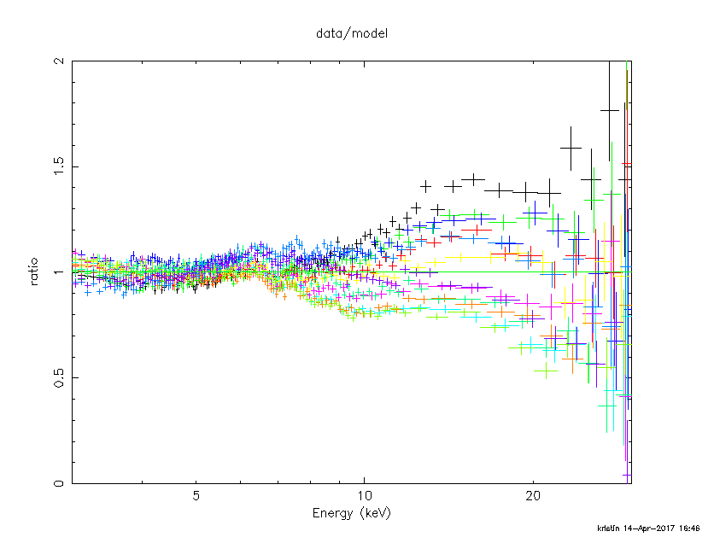
GX 13+1: time resolved spectroscopy
 | Orbit1 | Orbit2 | Orbit5 | Orbit10 | Flare
Gauss Line E | 6.2 | 6.28 | 6.16 | 6.3 | 6.37
Gauss width | 0.86 | 0.8 | 0.94 | 0.87 | 0.7(f)
CompTb[1]
kTs | 0.91 | 0.94 | 0.94 | 1.1 | 1.66
alpha | 1.69 | 2.3 | 1.57 | 1.2 | 0.67
kTe | 2.26 | 2.25 | 1.94 | 1.98 | 1.86
delta | 9.14 | 46.8 | 7.2 | 4.21 | 5.43
logA | -0.40 | -0.67 | -0.64 | -0.7 | -0.65
Tau | 4.2 | 3.2 | 4.8 | 5.8 | 8.9
CompTb[2]
kTs | 0.1 | 0.1 | 0.1 | 0.1 | 0.15
alpha | 0.7 | 0.72 | 0.8 | 0.8 | 0.75
kTe | 2.26 | 2.25 | 1.94 | 1.98 | 1.86
delta | 0 | 0 | 0 | 0 | 0 (f)
logA | 8 | 8 | 8 | 8 | 8 (f)

Slide 60
Bright sources are fun but they are not easy
Complex details show up and it can be hard to tell what is real and what is instrumental
You can’t get everything right, so you need to understand how it affects your results

