Slide 1
The Missions III –
NuSTAR S/C & Instruments
Kristin Kruse Madsen
Caltech

Slide 2
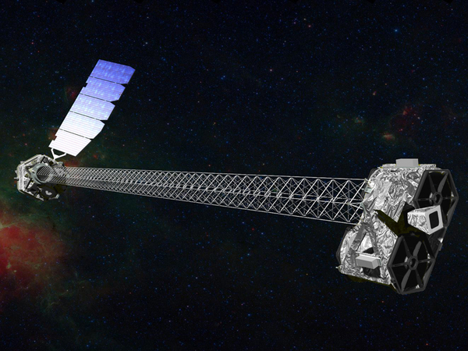
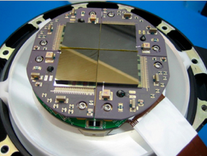
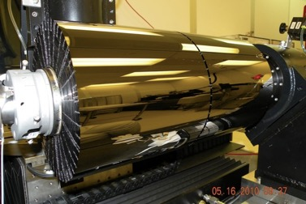
Nuclear Spectroscopic Telescope ARray
3 – 79 KeV
10 meters
FPMA & FPMB
OMA & OMB

Slide 3
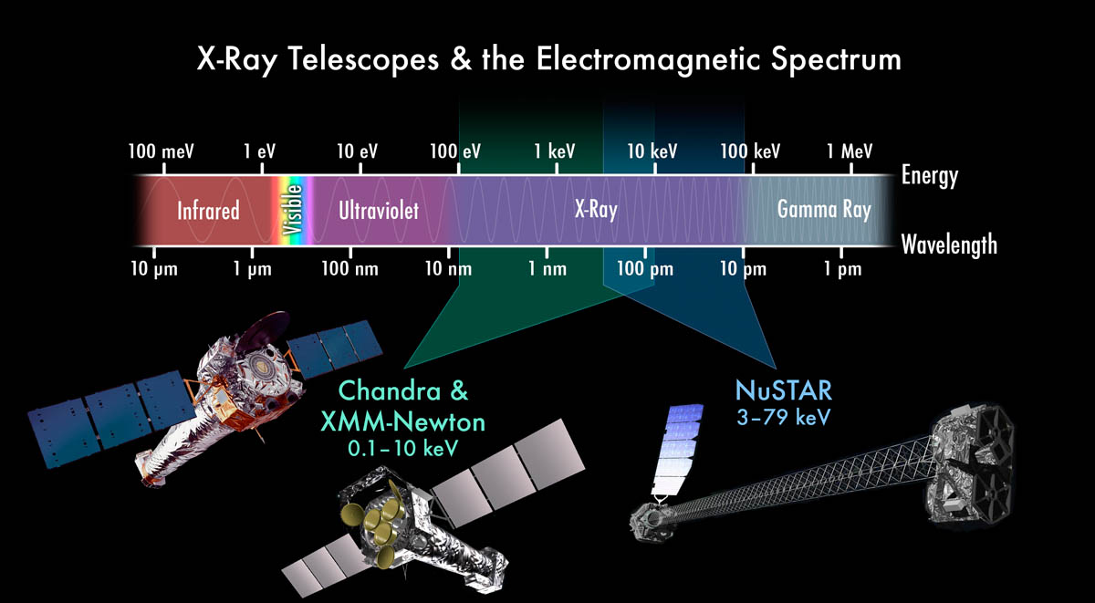

Slide 4
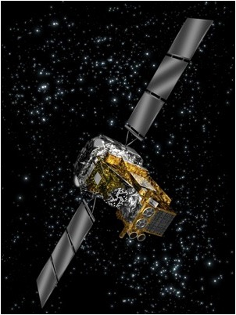
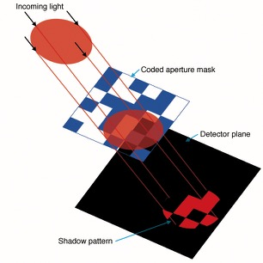
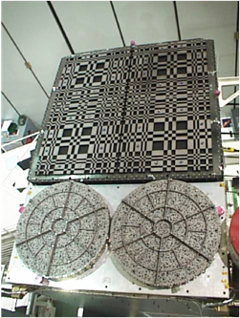
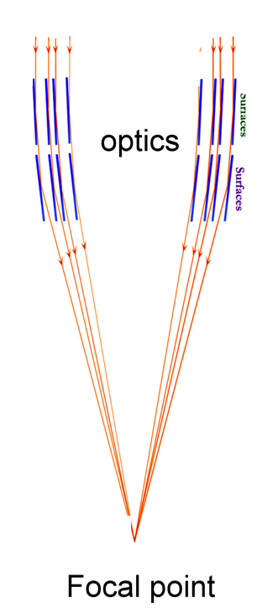
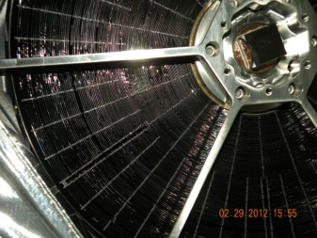
Collimated v. focusing optics
Integral

Slide 5
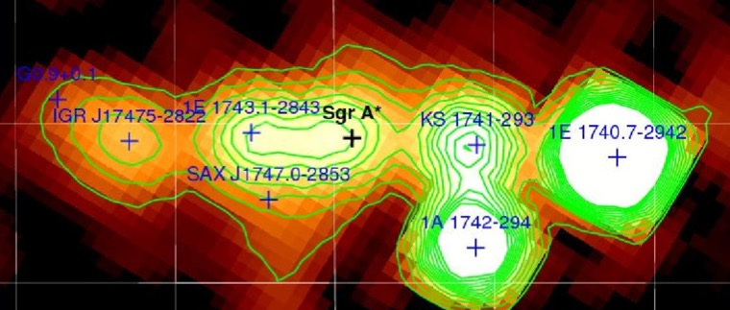
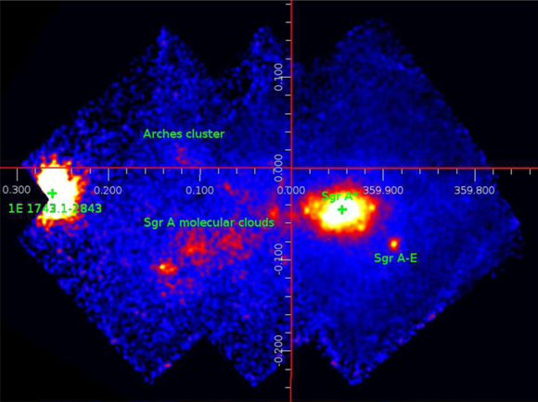
The Galactic Center
Integral
Integral
Collimated:
Focused:

Slide 6
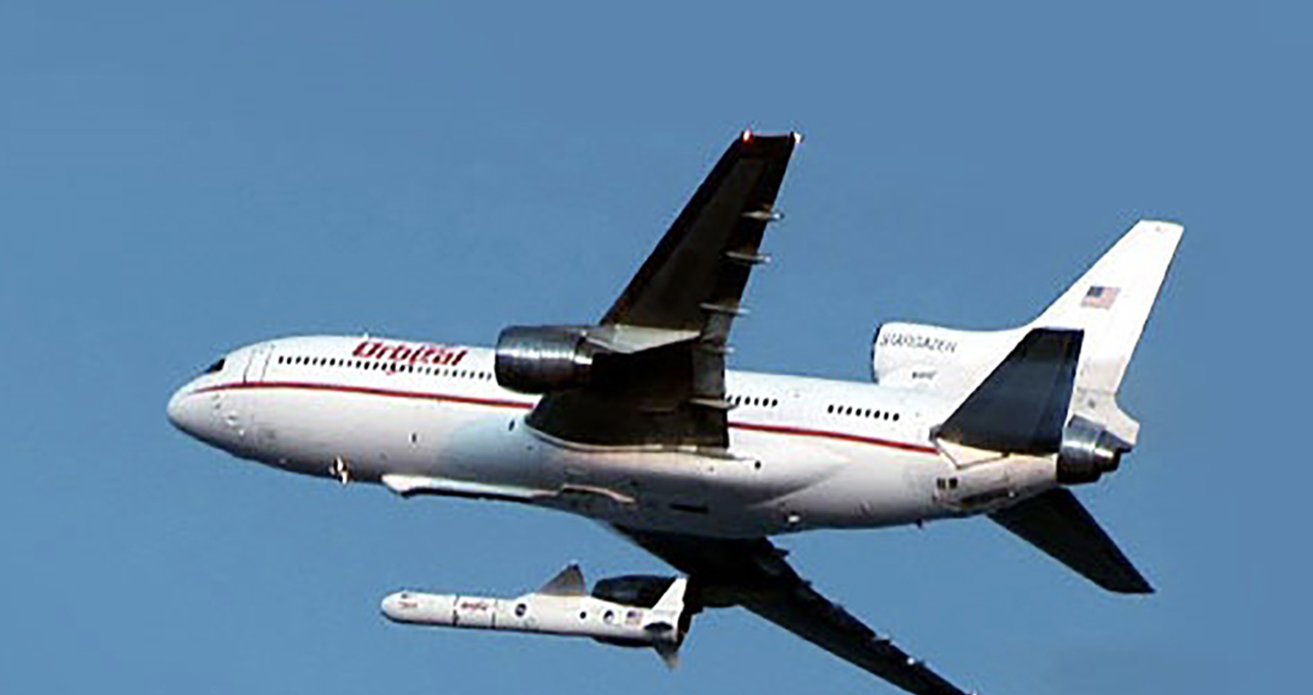
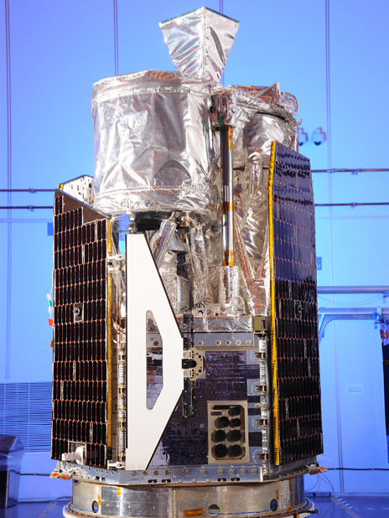
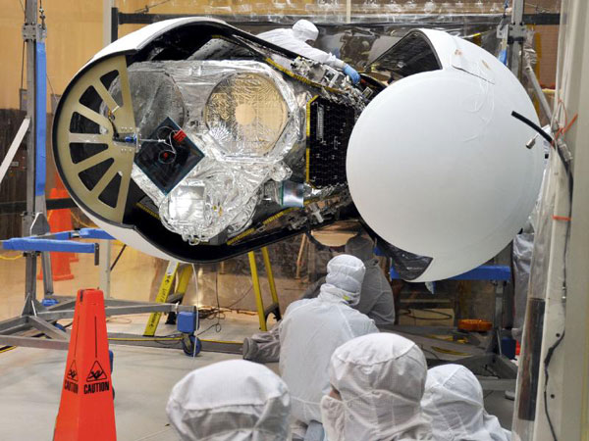
Launch 13 June 2012
SMEX – Small Mission Explorer, smallest NASA satellite class, $150M

Slide 7
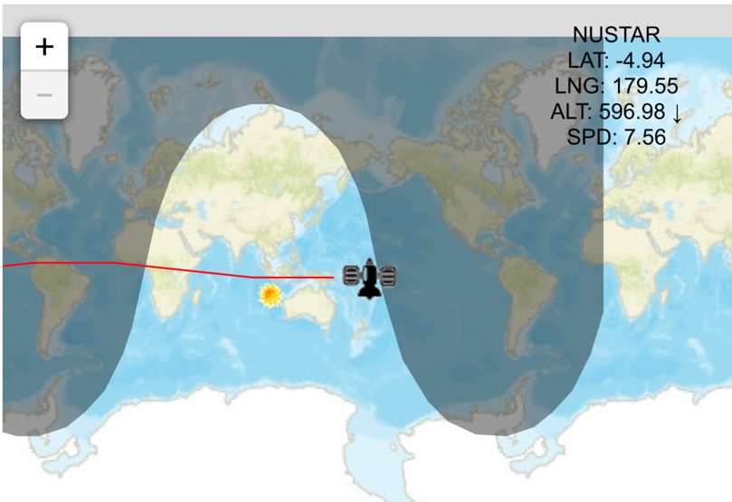
Orbital mechanics
LEO, Low Earth Orbit @ 6 degrees.
Altitude ~600km
One orbit ~ 92 minutes
https://www.n2yo.com

Slide 8
Effective Area

Slide 9
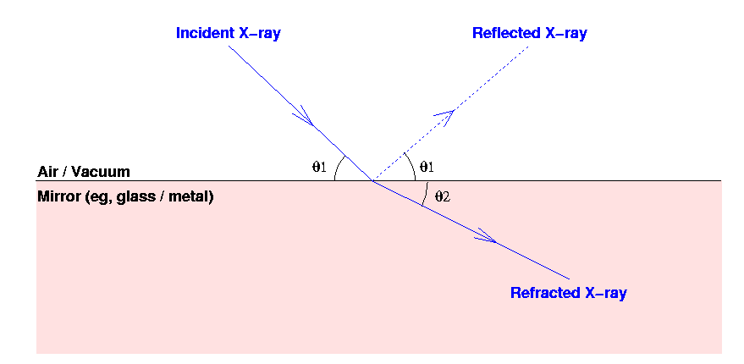
Refraction
X-rays bend slightly toward the surface (opposite from visible light) n= 1 - δ - iβ δ ∼ 10⁻³

Slide 10
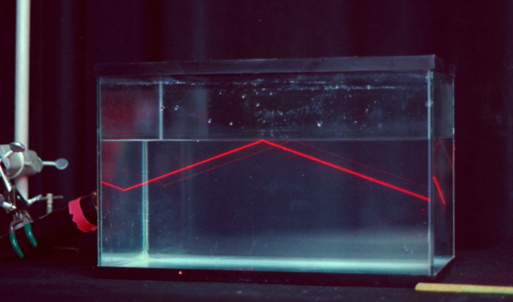
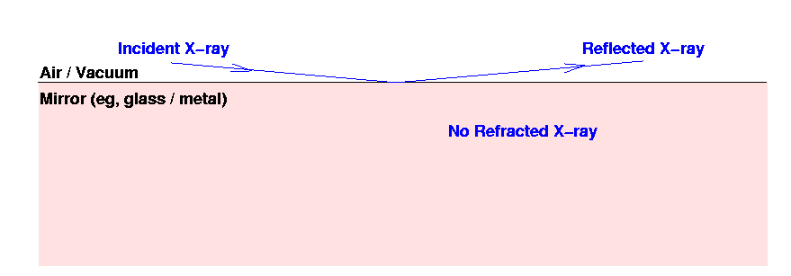
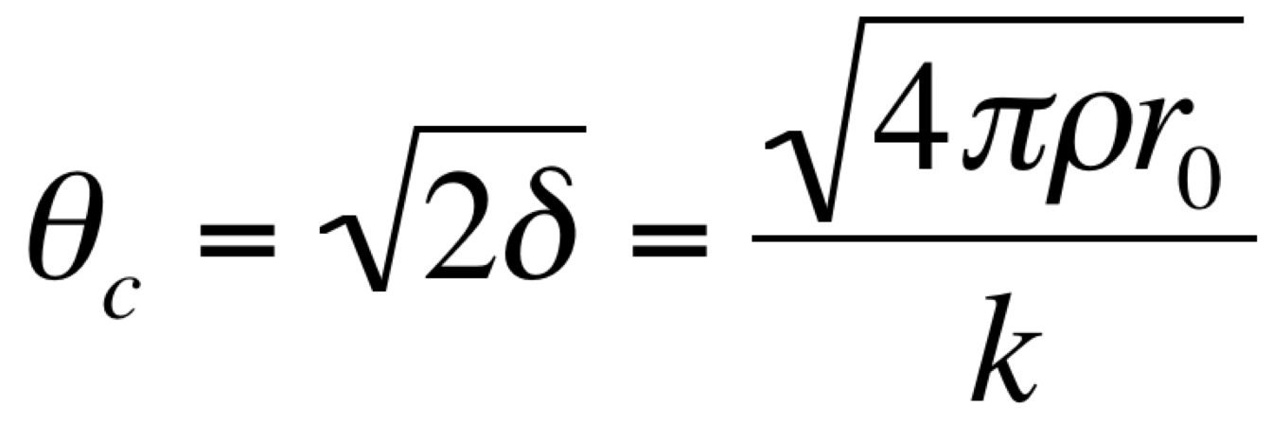
External reflection
Critical condition for total external reflection
Critical angles are very small (< 1 degree)
n= 1 - δ - iβ

Slide 11
Critical Angle

Slide 12
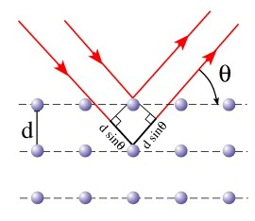
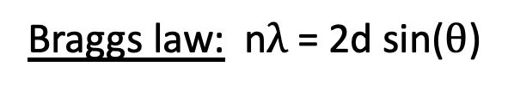
Constructive interference
Crystal lattice
Braggs law: n$λ$ = 2d sin($θ$)

Slide 13
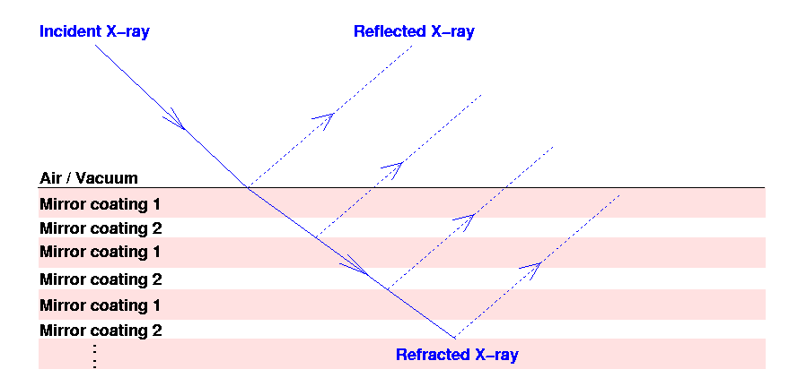
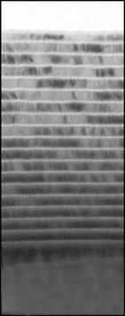
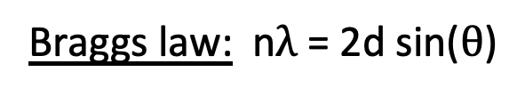
Constructive interference multilayers
Braggs law: n$λ$ = 2d sin($θ$)
Few nm (10⁻⁹m) thickness
1/2000 of a mm

Slide 14
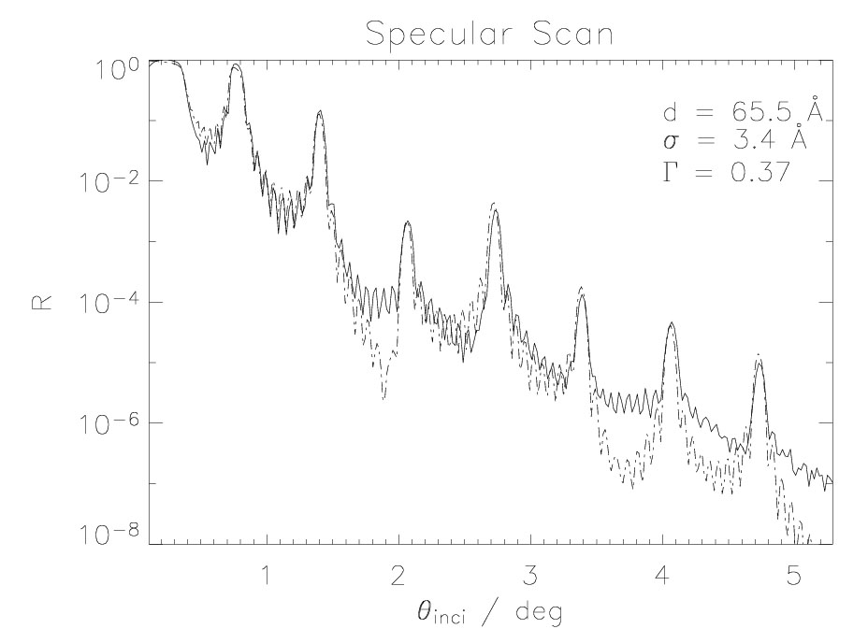
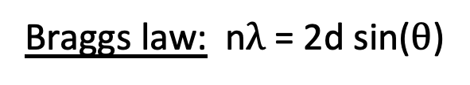
Bragg peaks
Braggs law: n$λ$ = 2d sin($θ$)
1st bragg peak
4th bragg peak
Kissing fringes

Slide 15
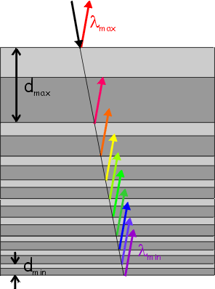
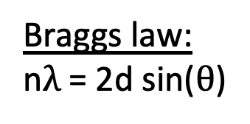
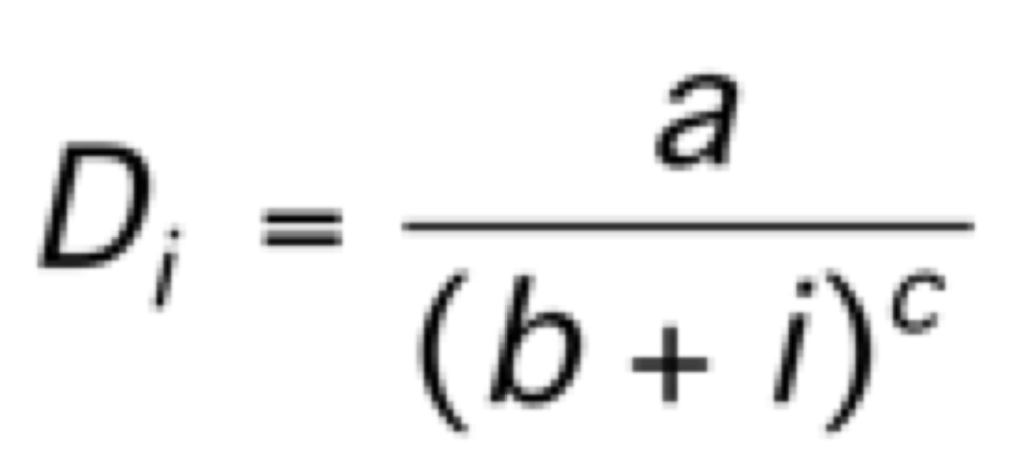
Depth Graded Multilayers
Braggs law:
n$λ$ = 2d sin($θ$)
High Z
Low Z
i=1
N
Material combinations:
W/Si K-edge: 69.53 keV
Pt/C K-edge: 78.4 keV
Typical parameters:
N = 145, 291
D_{min} ~ 3 nm
D_{max} ~ 12 nm
Depth
Grading:
i = 1,N

Slide 16
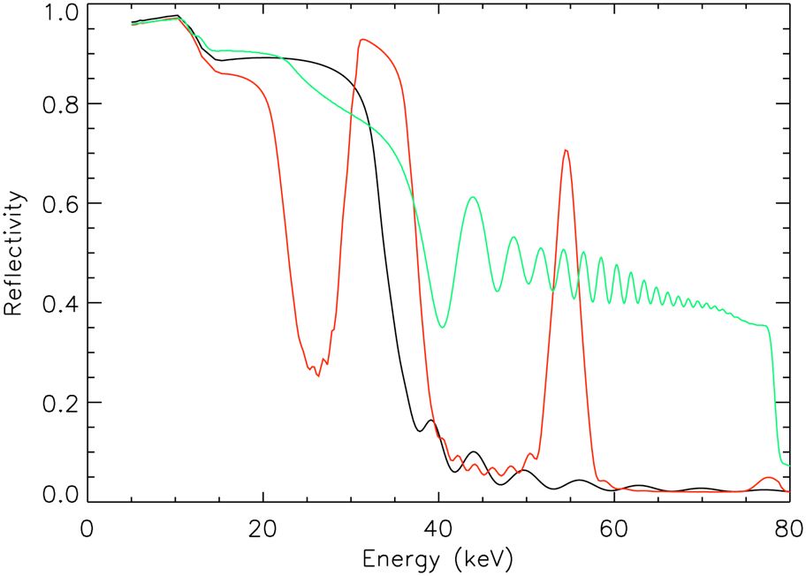
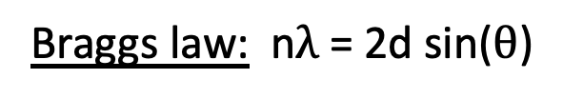
Depth Graded Multilayers
Braggs law: n$λ$ = 2d sin($θ$)
Pt, 30 nm
Pt/C constant-10, D=10 nm
Pt/C mirror group 5
θ_{inc} = 2.50 mrad

Slide 17
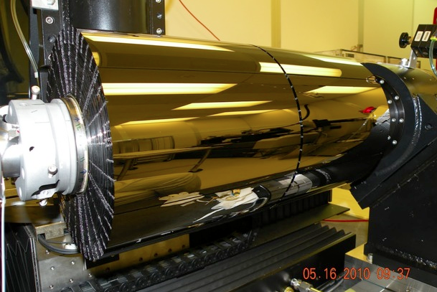
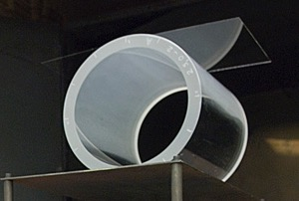
Optics
Conical Wolter I approximation
Parameter | Value
Minimum radius | 5.44 cm
Maximum radius | 19.12 cm
Mirror length | 22.7 cm
Focal Length | 1015 cm
Number of Shells | 133
Depth Graded Multilayers:
Inner shells (1 - 89) | Pt/C
Outer shells (90 - 133) | W/Si
Substrates:
Slumped Borosilicate t=0.21 mm

Slide 18
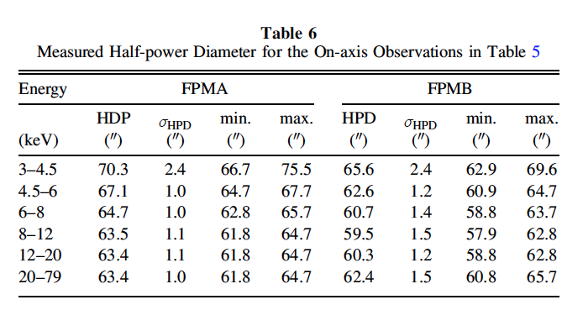
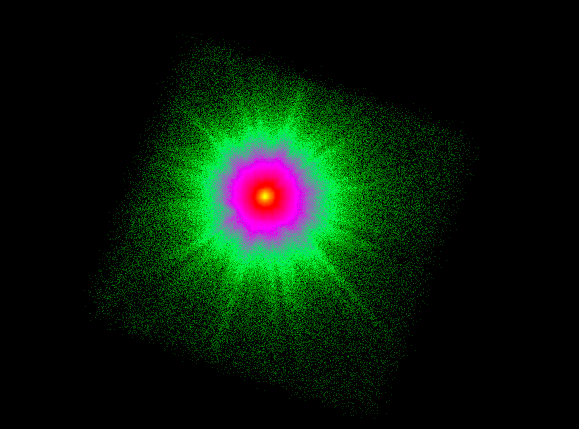
PSF

Slide 19
Focal Plane Detectors
CdZnTe
4 crystals (2 x 2 cm)
32 x 32 pixels/crystal
pixel pitch 0.6 mm
E/dE = 1 keV

Slide 20
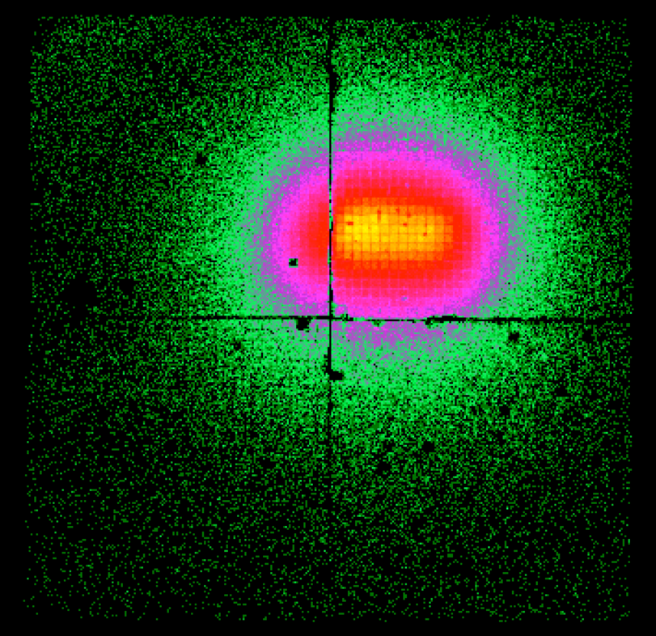
Anatomy lesson
Two modules: FPMA and FPMB
Each module has 4 detectors
Each detector has 32 x 32 pixels.
Physical pixel size: 12.3”
Software pixel size 1/5th of physical: 2.45”
FoV: 4 x 4 cm = 13.5’ x 13.5’
Det 1
Det 0
Det 2
Det 3
4 cm, 13.5’

Slide 21
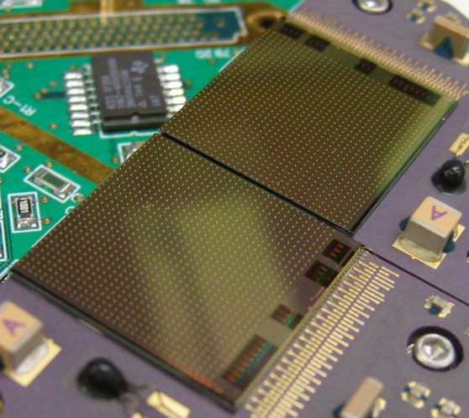
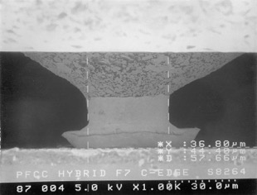
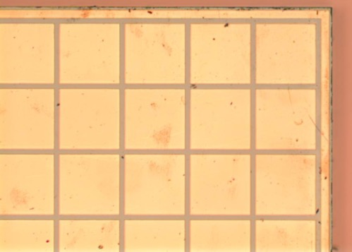
Hybrid Detector Design
Epoxy-gold stud interconnect
2mm thick CdZnTe
0.6 mm
ASIC (application-specific integrated circuit)
Each physical pixel is subdivided in 5x5

Slide 22
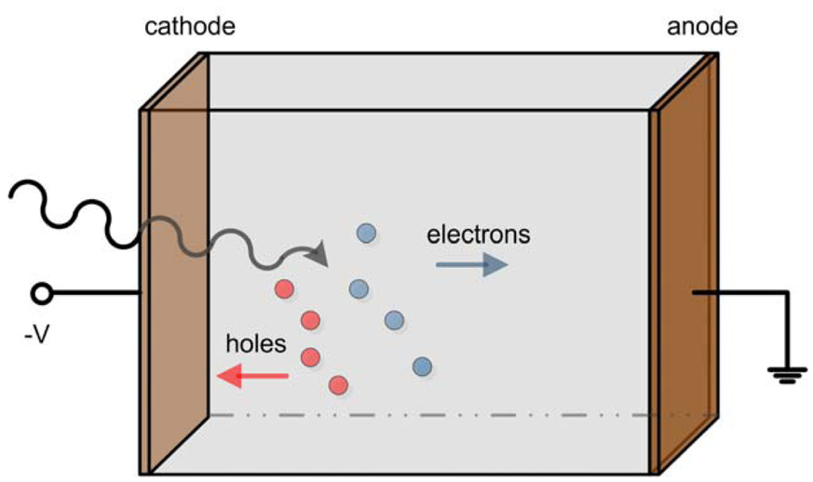
Hybrid Architecture
ASIC readouts bipolar signal, so collects signal from both electrons and holes.
When triggered, reads out a 3x3 grid
- Largest pulse height
- non-triggered (Hole signal)
9-pixel read out

Slide 23
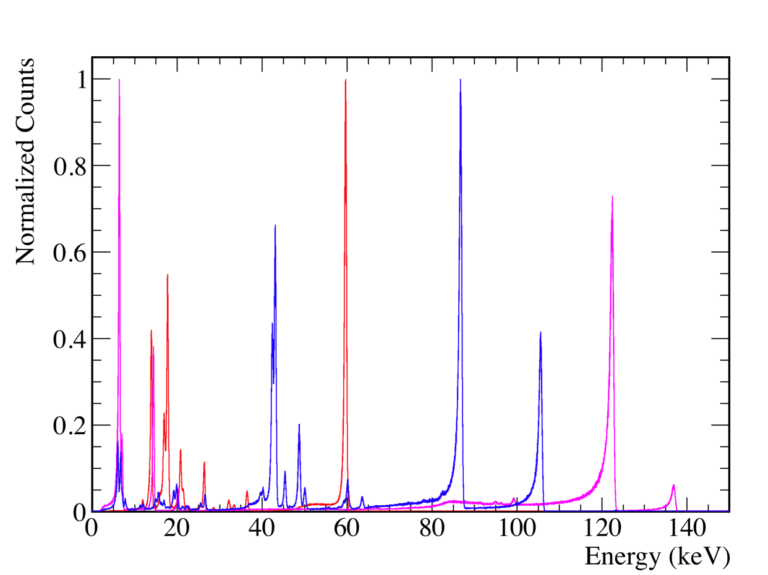
Observed CdZnTe Spectra
59.54 keV
⁵⁷Co
¹⁵⁵Eu
²⁴¹Am
86.54 keV
122 keV
0.6 keV FWHM
Low-energy tail due to poor hole transport

Slide 24
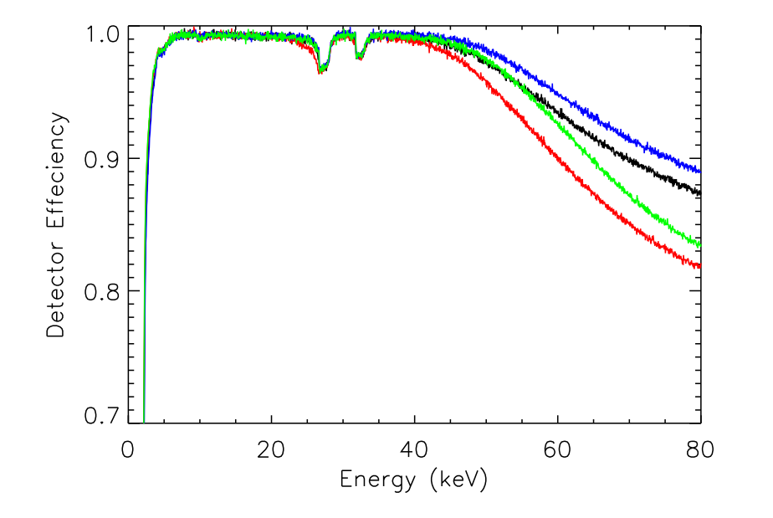
Detector Efficiency
Escape lines
Cd & Te
Detector 0
Detector 1
Detector 2
Detector 3
Thickness of detector variations

Slide 25
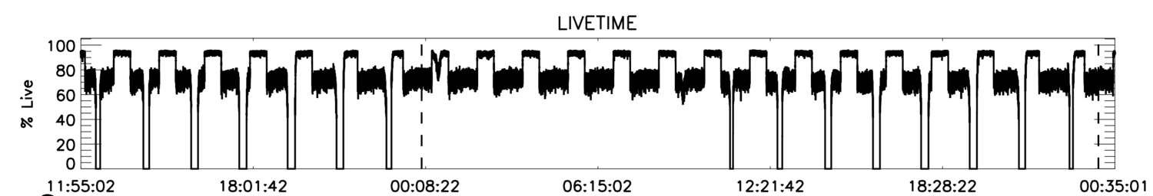
Deadtime
33ms pulse profile
Deadtime
distortion
When a photon triggers the threshold, the entire module freezes and will no longer register a photon until the previous photon has been read out.
This period is called the DEADTIME and lasts for ~ 2.5ms.
The actual exposure time for a source is therefore:
Exposure = on time * % livetime
Deadtime
corrected

Slide 26
Operation
http://www.srl.caltech.edu/NuSTAR_Public/NuSTAROperationSite/Home.php
http://www.nustar.caltech.edu
One Guest Observer call per year: https://heasarc.gsfc.nasa.gov/docs/nustar/nupropthread.html
  Just had AO-9 in January 26
  Next AO-10 will be in January 2024

Slide 27
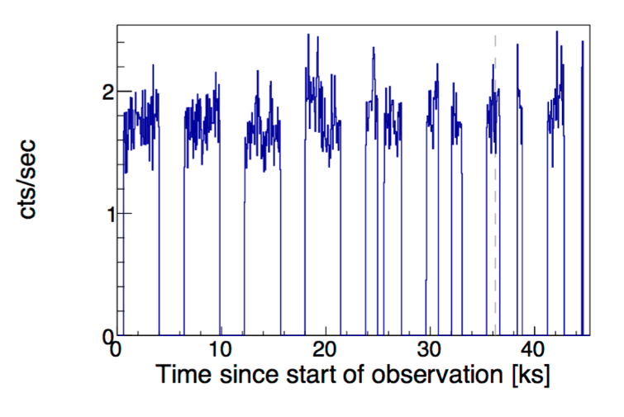
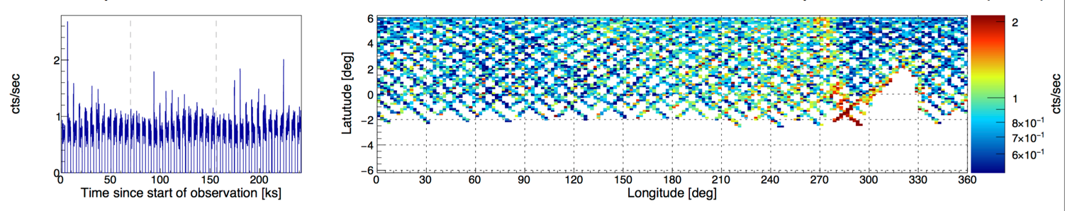
SAA passages
For each orbit, the target is occulted about 40-50 % of the time due to the earth getting in the way and because of the SAA (South Atlantic Anomaly)
Occultation
SAA passage

Slide 28
What is NuSTAR good at
Broadband spectroscopy
  3 – 78 keV
Hard X-rays > 10 keV
Bright targets
  Not affected by pileup like CCDs

Slide 29
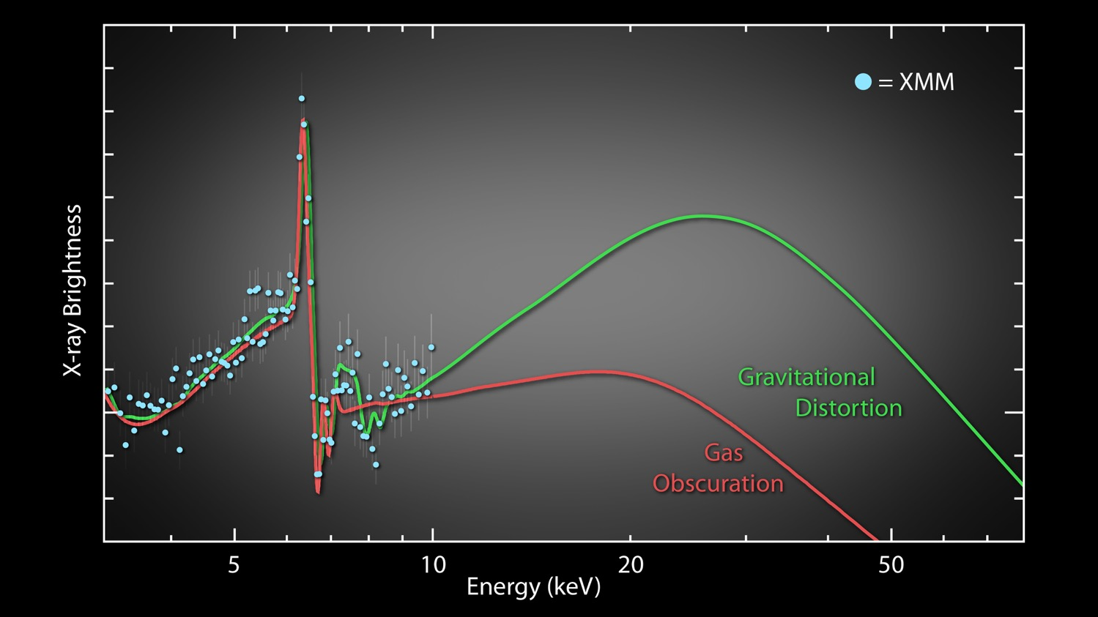
NuSTAR synergy
Risaliti et al, Nature, 2013
NGC 1365

Slide 30
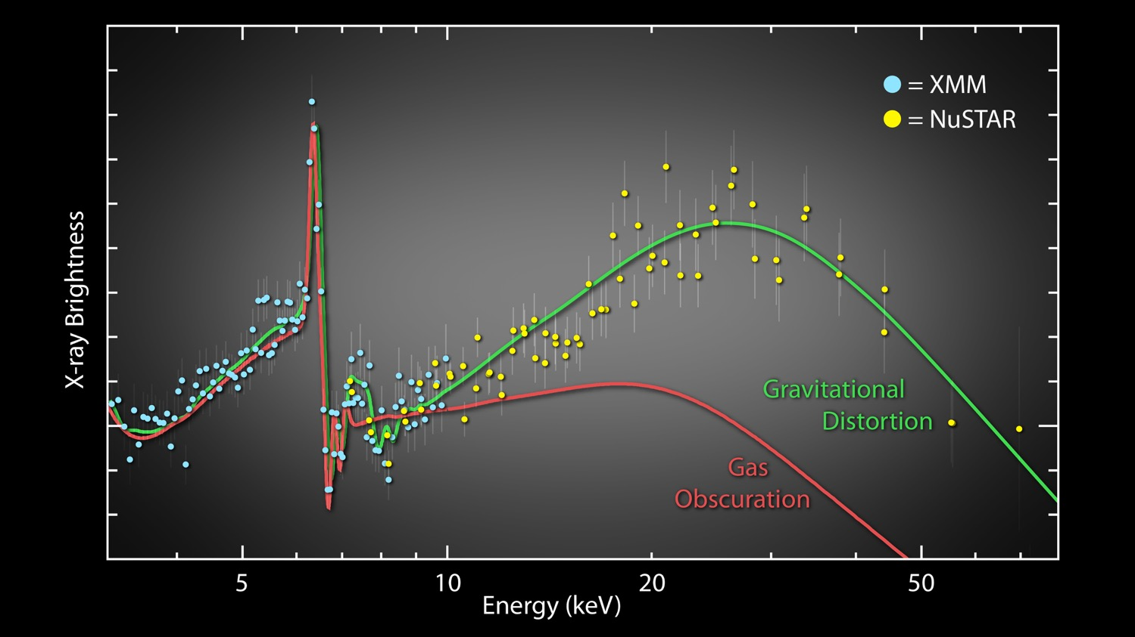
NuSTAR synergy
Risaliti et al, Nature, 2013
NGC 1365

Slide 31
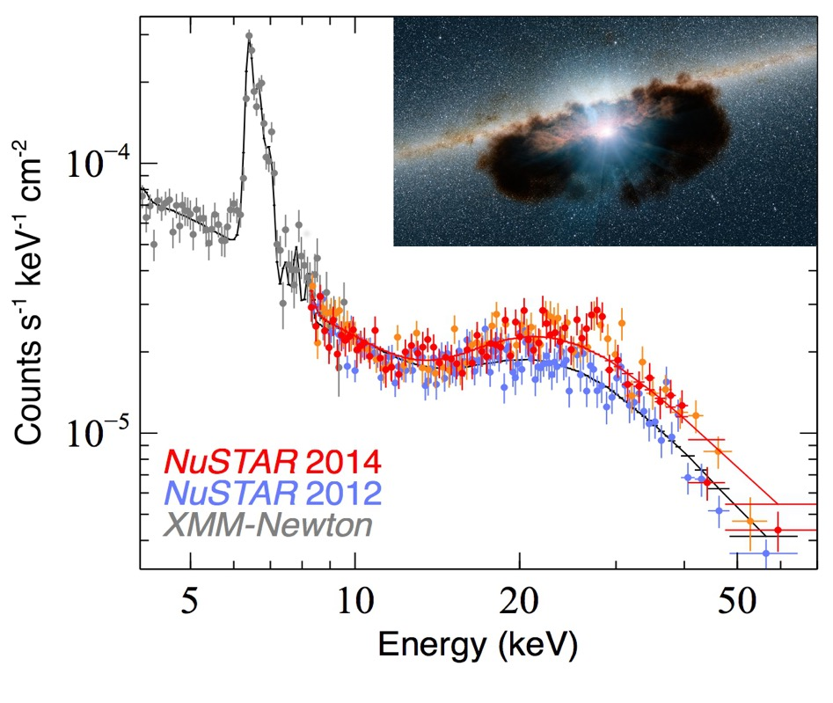
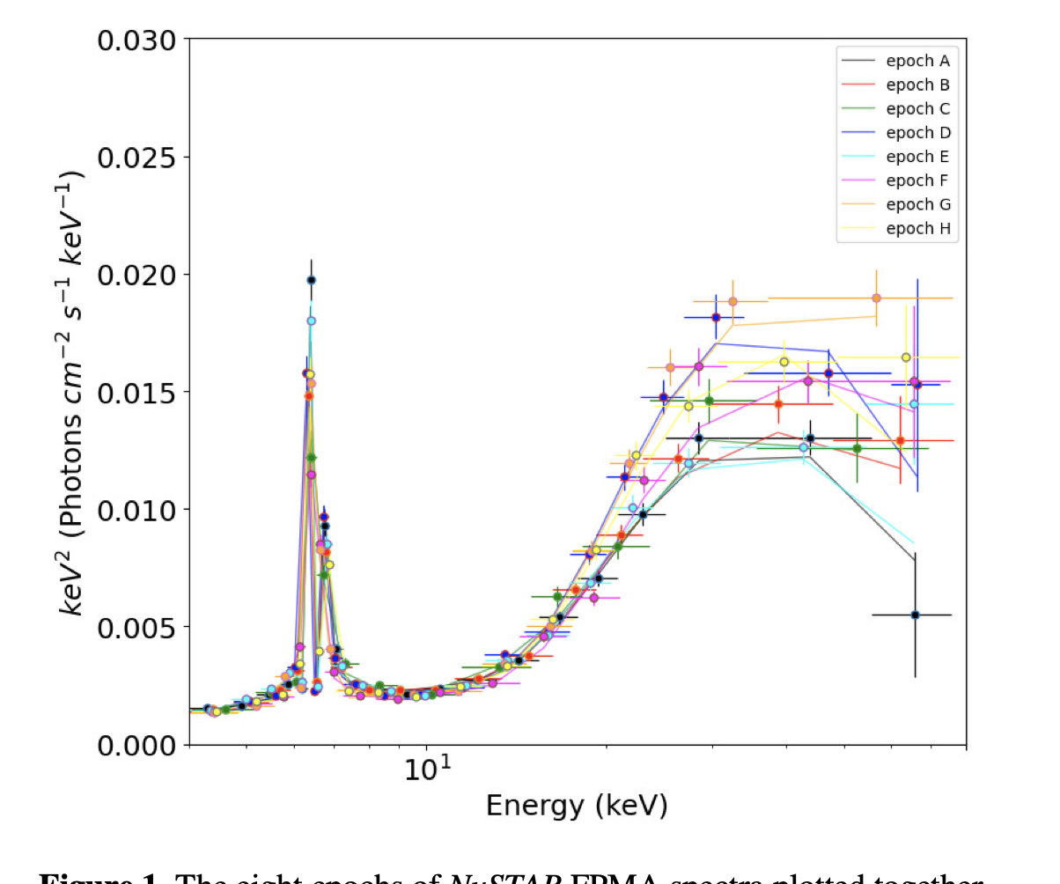
Clumpy torus
NGC 1068
Bauer et al, Apj, 2015
Marinucci et al, MNRAS, 2016
Zaino et al, MNRAS, 2020
Indrani et al, MNRAS, 2022

Slide 32
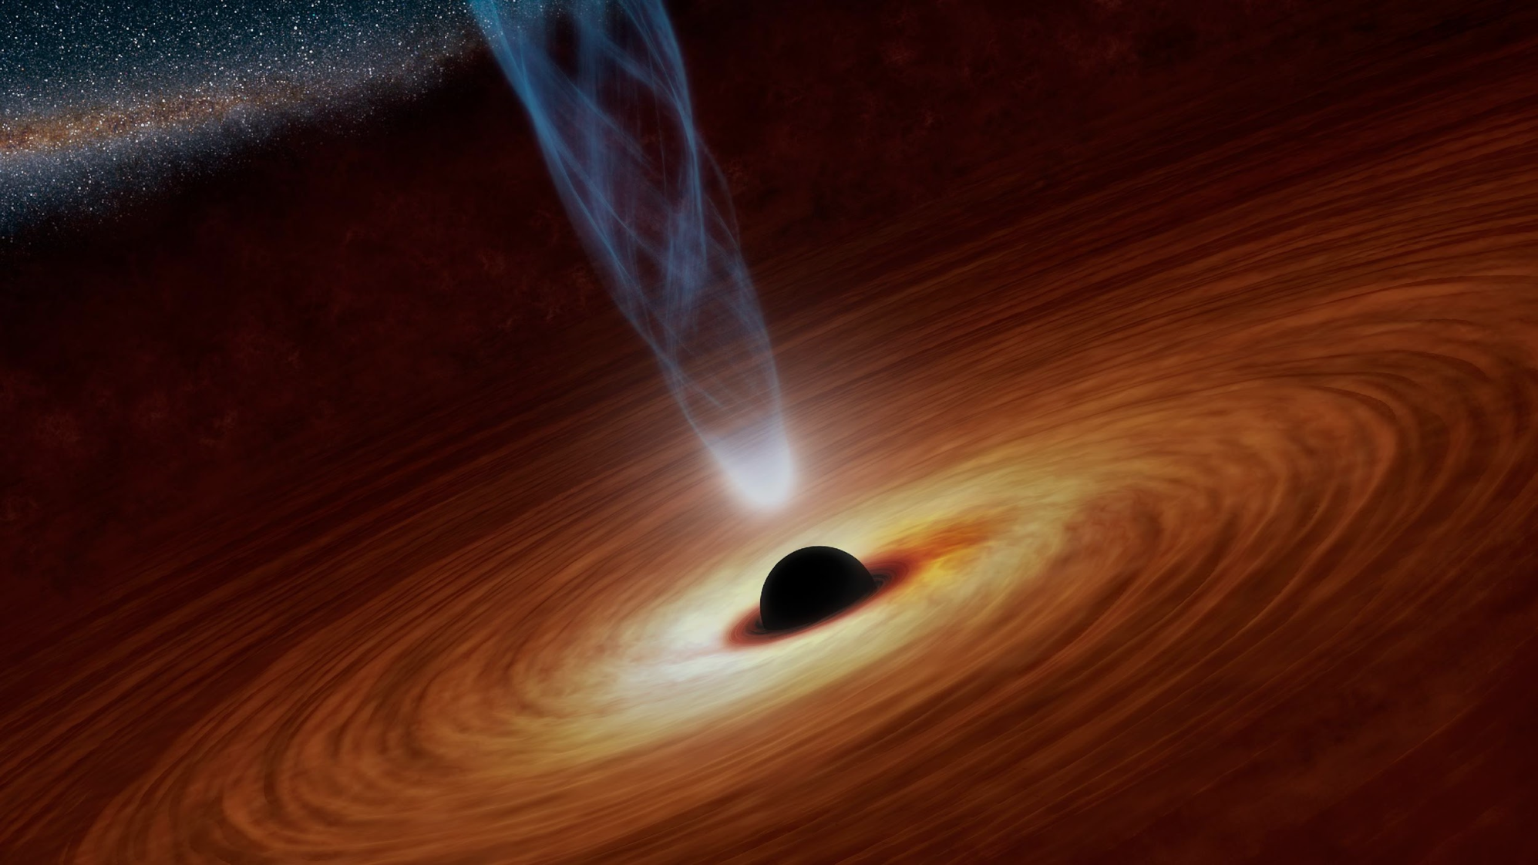
Extreme Physics of Accretion
Jet Formation and Power
Black Hole Spin and Mass
(Reflection Spectroscopy
And Reverberation Mapping)
Physical Properties of the X-ray Corona
Temporal Evolution of the Central Engine
Disk Inner-Radius Estimates:
Properties of the Accretion Flow,
Neutron Star Equation of State
Probe Extreme Gravity: High-Density Plasmas, Tests of GR, etc.
Notes:
While I have until now mostly talked about understanding the numbers and populations, we need to understand the physics that is responsible for the light we observe as well. At the heart of most X-ray phenomena lies accretion and in the basic picture, there is an accretion disk, emitting in the UV which are up-scattered by the corona, situated somewhere above. The accretion power is presumably supplied to the corona though magnetic fields wound up by the disc that intensely heat coronal electrons, which then cool rapidly by Comptonizing the lower energy photons above the accretion disc. The result is a hard X-ray power-law spectrum extending to just above the temperature of the bulk of the electrons. Some of this emission is also reflected off the thick accretion disk, generating a spectrum with an iron line and a characteristic Compton hump. By studying each of these components which are interleaved we learn vital facts about the geometry of accretion as shown here.

Slide 33




GX 339-4
Garcia et al, ApJ, 2019

Slide 34


Cyclotron lines
Vela X-1
HMXB GRO J1750-27
Diez et al, A&A, 2022
Sharma et al, MNRAS, 2022

Slide 35



Pulsars
G11.2+0.3
LMC X-4
ULX M82 X-2
McKinley et al, ApJ, 2019
Bachetti et al, ApJ, 2020
Madsen et al, ApJ, 2020

Slide 36



Cross-calibration with other observatories
Resources: International Consortium for High Energy Calibration (IACHEC) https://iachec.org

Slide 37



Bright Sources
J1658d2-4242
GRO J1744-28
GRS 1915+105
GRS 1915+105
GX13+1
N_{H}
MAXI J1820+070
MAXI J1820-070
Her X-1
Countrate

Slide 38

How NuSTAR points
Inertial_{OB}
NuSTAR points from the rear (FB) and because thermal gradients cause the mast to bend, a laser metrology system keeps track of where the two benches are relative to each other.
The star tracker at the top is co-aligned with the optics and knows where the observatory is pointed with respect to the sky.
startracker
Optical Bench
Mast
Focal Plane Bench
Spacecraft Bus
Inertial_{FB}

Slide 39


Reconstruction of sky images
T_{mast}, Q_{mast}
+ Inertial_{OB}
Det1 coordinate system
Sky coordinate system

Slide 40

Ghost rays

Slide 41

Ghost rays

Slide 42



Stray Light

Slide 43


Background
NuSTAR Observations of the Bullet Cluster: Constraints on Inverse Compton Emission
Wik, Daniel R., Hornstrup, A., Molendi, S., et al., 2014, ApJ, 792, 48

Slide 44

Background spectrum
Aperture: varies with location on the sky.
Solar: varies with solar activity.
fCXB (focused Cosmic X-ray Background): Same as aperture, but focused.
Internal lines: varies with particle background.
Internal continuum: fairly stable.

Slide 45

MLI tear on the backside of FPMA

Slide 46


Slide 47




Slide 48

Instrument Summary

